Slide 1
Kubernetes in Action
Part V
2026.08.25

Slide 2
Sharing Information
Accessing Pod Metadata and Other Resources from Application

Slide 3
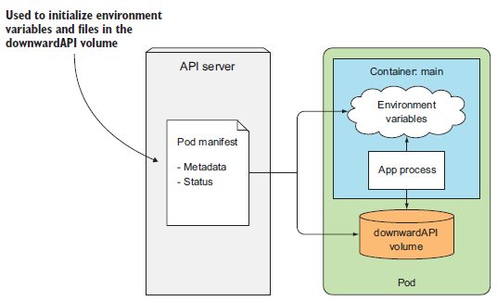
Passing Metadata Through the Downward API(1/12)
Downward API :
  In the previous part you saw how you can pass configuration data to your applications through environment variables or through configMap and secret volumes. This works well for data that you set yourself and that is known before the pod is scheduled to a node and run there. But what about data that isn’t known up until that point—such as the pod’s IP, the host node’s name, or even the pod’s own name (when the name is generated; for example, when the pod is created by a ReplicaSet or similar controller)? And what about data that’s already specified elsewhere, such as a pod’s labels and annotations? You don’t want to repeat the same information in multiple places.
  Both these problems are solved by the “Kubernetes Downward API”. It allows you to pass metadata about the pod and its environment through environment variables or files (in a “downwardAPI” volume). Don’t be confused by the name. The Downward API isn’t like a REST endpoint that your app needs to hit so it can get the data. It’s a way of having environment variables or files populated with values from the pod’s specification or status, as shown in the following figure.

Slide 4

Passing Metadata Through the Downward API(2/12)
Understanding the Available Metadata :
  The Downward API enables you to expose the pod’s own metadata to the processes running inside that pod. Currently, it allows you to pass the following information to your containers :
    The pod’s name
    The pod’s IP address
    The namespace the pod belongs to
    The name of the node the pod is running on
    The name of the service account the pod is running under
    The CPU and memory requests for each container
    The CPU and memory limits for each container
    The pod’s labels
    The pod’s annotations
  A service account is the account that the pod authenticates as when talking to the API server. CPU and memory requests and limits are the amount of CPU and memory guaranteed to a container and the maximum amount it can get.
  Most items in the list can be passed to containers either through environment variables or through a downwardAPI volume, but labels and annotations can only be exposed through the volume. Part of the data can be acquired by other means (for example, from the operating system directly), but the Downward API provides a simpler alternative.

Slide 5
Passing Metadata Through the Downward API(3/12)
Exposing Metadata Through Environment Variables :
  Let’s look at how you can pass the pod’s and container’s metadata to the container through environment variables. You’ll create a simple single-container pod from the following listing’s manifest.
apiVersion: v1
kind: Pod
metadata:
name: downward
spec:
containers:
- name: main
image: busybox
command: ["sleep", "9999999"]
resources:
requests:
cpu: 15m
memory: 100Ki
limits:
cpu: 100m
memory: 6Mi # NOTICE : Minimum is 6Mi
env:
- name: POD_NAME
valueFrom:
fieldRef:
fieldPath: metadata.name
- name: POD_NAMESPACE
valueFrom:
fieldRef:
fieldPath: metadata.namespace
- name: POD_IP
valueFrom:
fieldRef:
fieldPath: status.podIP
- name: NODE_NAME
valueFrom:
fieldRef:
fieldPath: spec.nodeName
- name: SERVICE_ACCOUNT
valueFrom:
fieldRef:
fieldPath: spec.serviceAccountName
- name: CONTAINER_CPU_REQUEST_MILLICORES
valueFrom:
resourceFieldRef:
resource: requests.cpu
divisor: 1m
- name: CONTAINER_MEMORY_LIMIT_KIBIBYTES
valueFrom:
resourceFieldRef:
resource: limits.memory
divisor: 1Ki
downward-api-env.yaml

Slide 6
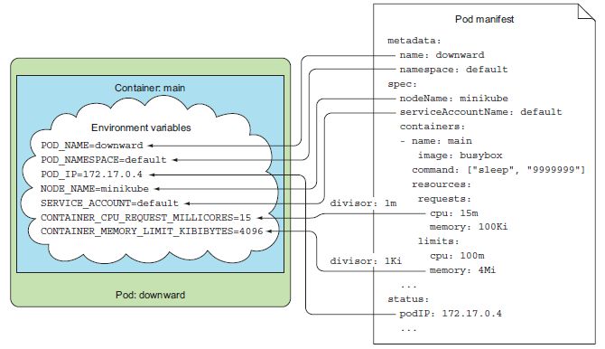
Passing Metadata Through the Downward API(4/12)
Exposing Metadata Through Environment Variables :
  When your process runs, it can look up all the environment variables you defined in the pod spec. The following figure shows the environment variables and the sources of their values. The pod’s name, IP, and namespace will be exposed through the POD_NAME, POD_IP, and POD_NAMESPACE environment variables, respectively. The name of the node the container is running on will be exposed through the NODE_NAME variable. The name of the service account is made available through the SERVICE_ACCOUNT environment variable. You’re also creating two environment variables that will hold the amount of CPU requested for this container and the maximum amount of memory the container is allowed to consume.
  For environment variables exposing resource limits or requests, you specify a “divisor”. The actual value of the limit or the request will be divided by the divisor and the result exposed through the environment variable. In the previous example, you’re setting the divisor for CPU requests to “1m” (one milli-core, or one one-thousandth of a CPU core). Because you’ve set the CPU request to 15m, the environment variable CONTAINER_CPU_REQUEST_MILLICORES will be set to 15. Likewise, you set the memory limit to 6Mi (6 mebibytes) and the divisor to 1Ki (1 Kibibyte), so the CONTAINER_MEMORY _LIMIT_KIBIBYTES environment variable will be set to 6144.
  NOTICE : The minimum memory request size is 6Mi.
  The divisor for CPU limits and requests can be either 1, which means one whole core, or 1m, which is one millicore. The divisor for memory limits/requests can be 1 (byte), 1k (kilobyte) or 1Ki (kibibyte), 1M (megabyte) or 1Mi (mebibyte), and so on.

Slide 7
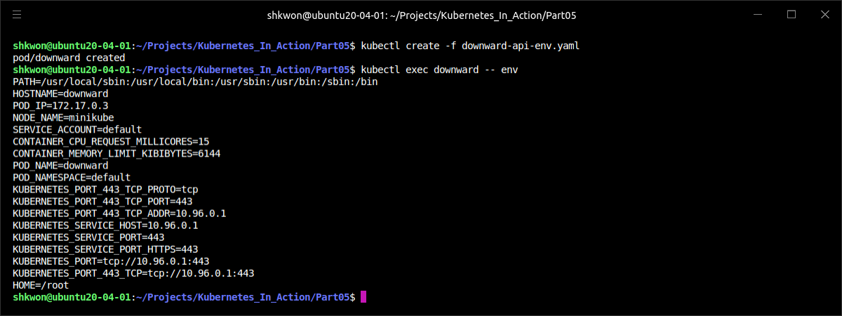
Passing Metadata Through the Downward API(5/12)
Exposing Metadata Through Environment Variables :
  After creating the pod, you can use “$ kubectl exec” to see all these environment variables in your container, as shown in the following listing.
  All processes running inside the container can read those variables and use them whenever they need.
$ kubectl create -f downward-api-env.yaml
$ kubectl exec downward -- env

Slide 8
Passing Metadata Through the Downward API(6/12)
Passing Metadata Through Files in a downwardAPI Volume :
  If you prefer to expose the metadata through files instead of environment variables, you can define a downwardAPI volume and mount it into your container. You must use a downwardAPI volume for exposing the pod’s labels or its annotations, because neither can be exposed through environment variables.
  As with environment variables, you need to specify each metadata field explicitly if you want to have it exposed to the process. Let’s see how to modify the previous example to use a volume instead of environment variables, as shown in the following listing.
apiVersion: v1
kind: Pod
metadata:
name: downward
labels:
foo: bar
annotations:
key1: value1
key2: |
multi
line
value
spec:
containers:
- name: main
image: busybox
command: ["sleep", "9999999"]
resources:
requests:
cpu: 15m
memory: 100Ki
limits:
cpu: 100m
memory: 6Mi
volumeMounts:
- name: downward
mountPath: /etc/downward
volumes:
- name: downward
downwardAPI:
items:
- path: "podName"
fieldRef:
fieldPath: metadata.name
- path: "podNamespace"
fieldRef:
fieldPath: metadata.namespace
- path: "labels"
fieldRef:
fieldPath: metadata.labels
- path: "annotations"
fieldRef:
fieldPath: metadata.annotations
- path: "containerCpuRequestMilliCores"
resourceFieldRef:
containerName: main
resource: requests.cpu
divisor: 1m
- path: "containerMemoryLimitBytes"
resourceFieldRef:
containerName: main
resource: limits.memory
divisor: 1Ki
downward-api-volume.yaml

Slide 9
Passing Metadata Through the Downward API(7/12)
Passing Metadata Through Files in a downwardAPI Volume :
  Instead of passing the metadata through environment variables, you’re defining a volume called “downward” and mounting it in your container under “/etc/downward”. The files this volume will contain are configured under the “downwardAPI.items” attribute in the volume specification.
  Each item specifies the path (the filename) where the metadata should be written to and references either a pod-level field or a container resource field whose value you want stored in the file (see the following figure).

Slide 10
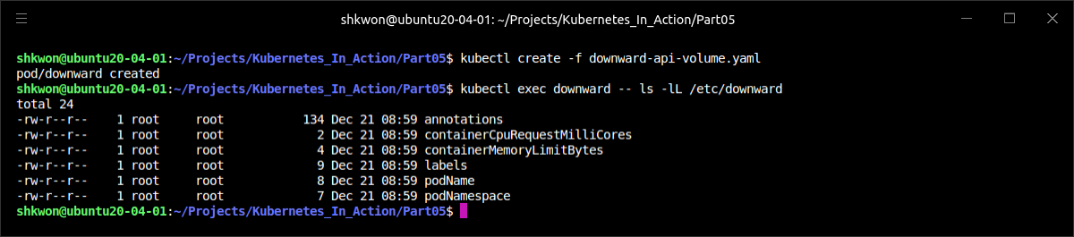
Passing Metadata Through the Downward API(8/12)
Passing Metadata Through Files in a downwardAPI Volume :
  Delete the previous pod and create a new one from the manifest in the previous listing. Then look at the contents of the mounted downwardAPI volume directory. You mounted the volume under “/etc/downward/”, so list the files in there, as shown in the following listing.
  NOTE : As with the configMap and secret volumes, you can change the file permissions through the downwardAPI volume’s “defaultMode” property in the pod spec.
$ kubectl delete -f downward-api-env.yaml
$ kubectl create -f downward-api-volume.yaml
$ kubectl exec downward -- ls -lL /etc/downward

Slide 11
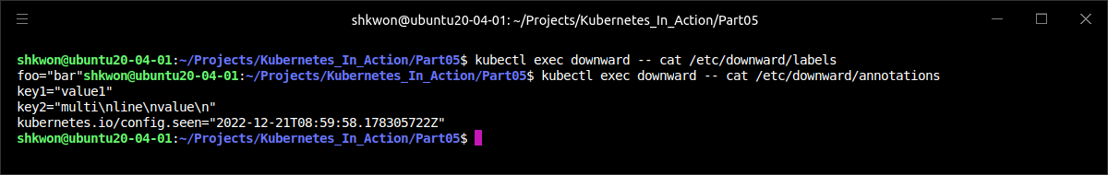
Passing Metadata Through the Downward API(9/12)
Passing Metadata Through Files in a downwardAPI Volume :
  Each file corresponds to an item in the volume’s definition. The contents of files, which correspond to the same metadata fields as in the previous example, are the same as the values of environment variables you used before, so we won’t show them here. But because you couldn’t expose labels and annotations through environment variables before, examine the following listing for the contents of the two files you exposed them in.
  NOTE : As you can see, each “label/annotation” is written in the “key=value” format on a separate line. Multi-line values are written to a single line with newline characters denoted with \n.
$ kubectl exec downward -- cat /etc/downward/labels
$ kubectl exec downward -- cat /etc/downward/annotations

Slide 12
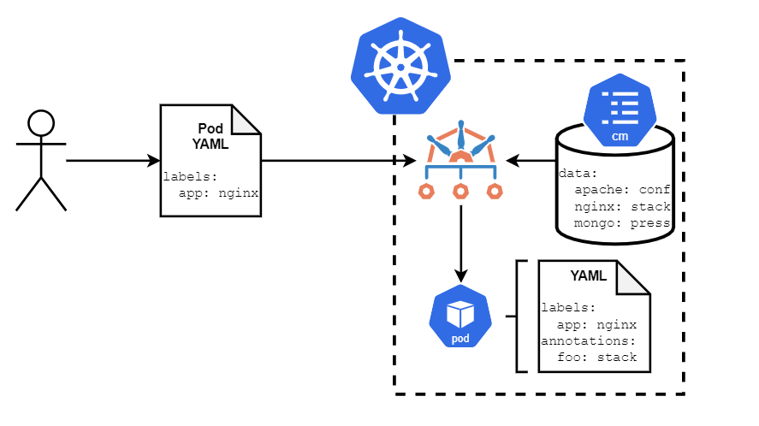
Passing Metadata Through the Downward API(10/12)
Passing Metadata Through Files in a downwardAPI Volume :
  Labels and annotations can be modified while a pod is running. As you might expect, when they change, Kubernetes updates the files holding them, allowing the pod to always see up-to-date data. This also explains why labels and annotations can’t be exposed through environment variables. Because environment variable values can’t be updated afterward, if the labels or annotations of a pod were exposed through environment variables, there’s no way to expose the new values after they’re modified.

Slide 13
Passing Metadata Through the Downward API(11/12)
Passing Metadata Through Files in a downwardAPI Volume :
  When exposing container-level metadata, such as a container’s resource limit or requests (done using “resourceFieldRef”), you need to specify the name of the container whose resource field you’re referencing, as shown in the following listing.
  The reason for this becomes obvious if you consider that volumes are defined at the pod level, not at the container level. When referring to a container’s resource field inside a volume specification, you need to explicitly specify the name of the container you’re referring to. This is true even for single-container pods.
  Using volumes to expose a container’s resource requests and/or limits is slightly more complicated than using environment variables, but the benefit is that it allows you to pass one container’s resource fields to a different container if needed (but both containers need to be in the same pod). With environment variables, a container can only be passed its own resource limits and requests.
spec:
volumes:
- name: downward
downwardAPI:
items:
- path: "containerCpuRequestMilliCores"
resourceFieldRef:
containerName: main
resource: requests.cpu
divisor: 1m

Slide 14
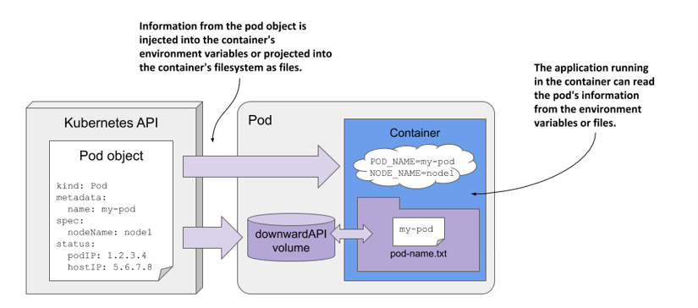
Passing Metadata Through the Downward API(12/12)
Passing Metadata Through Files in a downwardAPI Volume :
  The Downward API allows you to keep the application Kubernetes-agnostic. This is especially useful when you’re dealing with an existing application that expects certain data in environment variables. The Downward API allows you to expose the data to the application without having to rewrite the application or wrap it in a shell script, which collects the data and then exposes it through environment variables.
  But the metadata available through the Downward API is fairly limited. If you need more, you’ll need to obtain it from the Kubernetes API server directly.

Slide 15
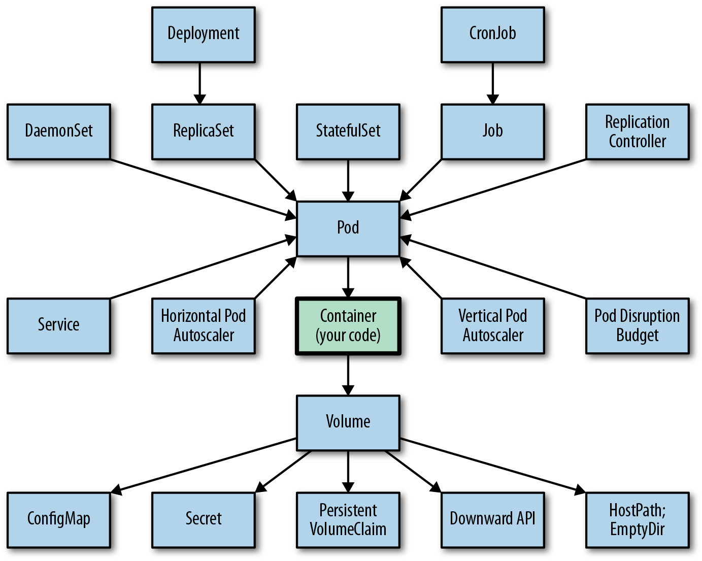
NOTE : The Big Picture
Kubernetes Objects :

Slide 16
Talking to the Kubernetes API Server(1/33)
The API Server :
  Sometimes your app will need to know more about other pods and even other resources defined in your cluster. The Downward API doesn’t help in those cases.
  Information about services and pods can be obtained by looking at the service-related environment variables or through DNS. But when the app needs data about other resources or when it requires access to the most up-to-date information as possible, it needs to talk to the API server directly (as shown in the following figure).

Slide 17
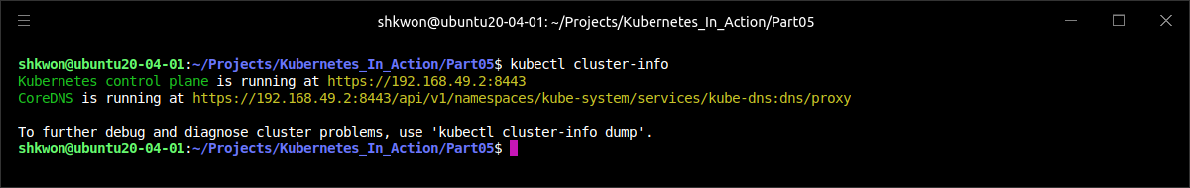
Talking to the Kubernetes API Server(2/33)
Exploring the Kubernetes REST API :
  If you’re planning on developing apps that talk to the Kubernetes API, you’ll want to know the API first. To do that, you can try hitting the API server directly. You can get its URL by running “$ kubectl cluster-info” command :
$ kubectl cluster-info

Slide 18
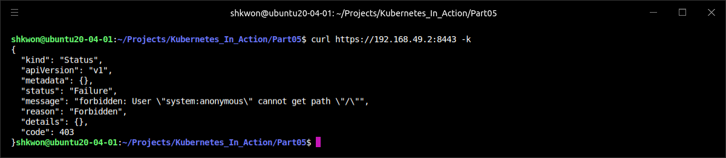
Talking to the Kubernetes API Server(3/33)
Exploring the Kubernetes REST API :
  Because the server uses HTTPS and requires authentication, it’s not simple to talk to it directly. You can try accessing it with “curl” and using curl’s “--insecure (or -k)” option to skip the server certificate check, but that doesn’t get you far :
  Rather than dealing with authentication yourself, you can talk to the server through a proxy by running the “$ kubectl proxy” command.
$ curl https://192.168.49.2:8443 -k

Slide 19
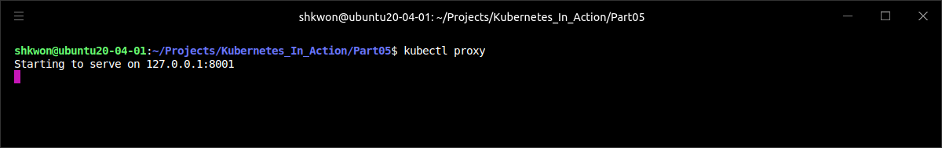
Talking to the Kubernetes API Server(4/33)
Accessing the API Server Through kubectl proxy :
  The kubectl proxy command runs a proxy server that accepts HTTP connections on your local machine and proxies them to the API server while taking care of authentication, so you don’t need to pass the authentication token in every request. It also makes sure you’re talking to the actual API server and not a man in the middle (by verifying the server’s certificate on each request).
  Running the proxy is trivial. All you need to do is run the following command :
  You don’t need to pass in any other arguments, because kubectl already knows everything it needs (the API server URL, authorization token, and so on).
$ kubectl proxy

Slide 20
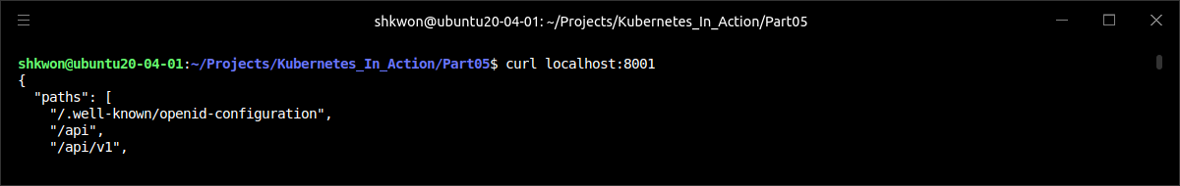
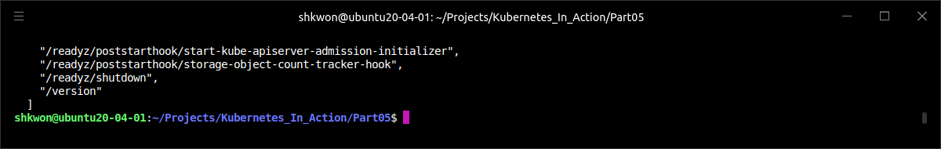
Talking to the Kubernetes API Server(5/33)
Accessing the API Server Through kubectl proxy :
  As soon as it starts up, the proxy starts accepting connections on local port 8001. Use the following command to access the proxy.
  NOTE : You sent the request to the proxy, it sent a request to the API server, and then the proxy returned whatever the server returned.
$ curl localhost:8001

Slide 21
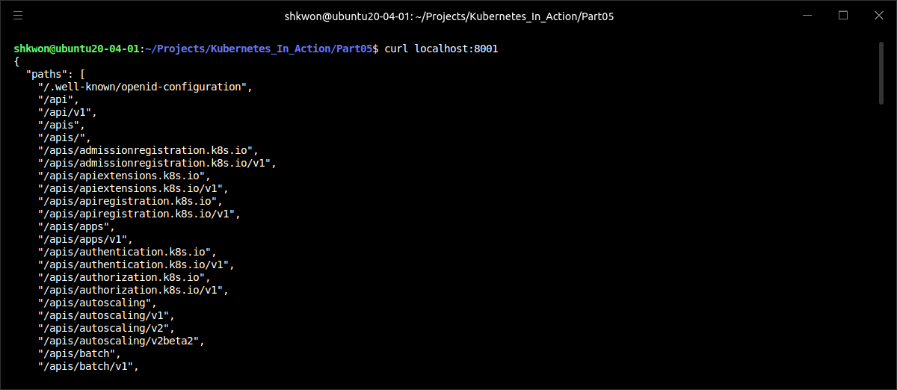
Talking to the Kubernetes API Server(6/33)
Exploring the Kubernetes API Through the kubectl proxy :
  You can continue to use “curl”, or you can open your web browser and point it to “http://localhost:8001”. Let’s examine what the API server returns when you hit its base URL more closely. The server responds with a list of paths, as shown in the following listing.
  NOTE : These paths correspond to the API groups and versions you specify in your resource definitions when creating resources such as Pods, Services, and so on.
$ curl http://localhost:8001

Slide 22
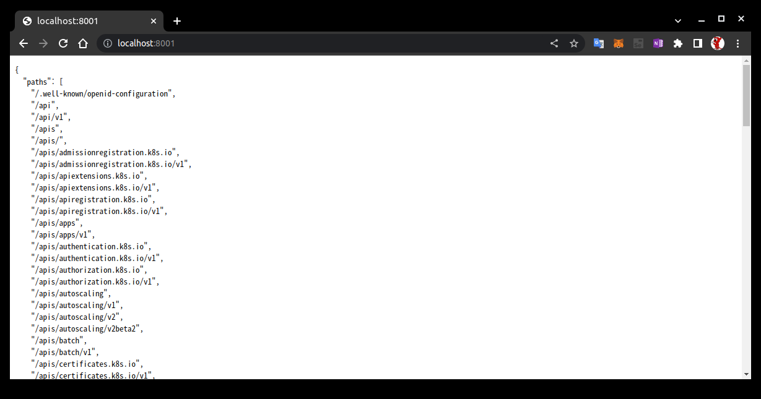
NOTE : Accessing API Server
Using Web Browser to Access the kubectl proxy :
  The following screenshot shows you that the same result will be given as the “curl” command output.

Slide 23
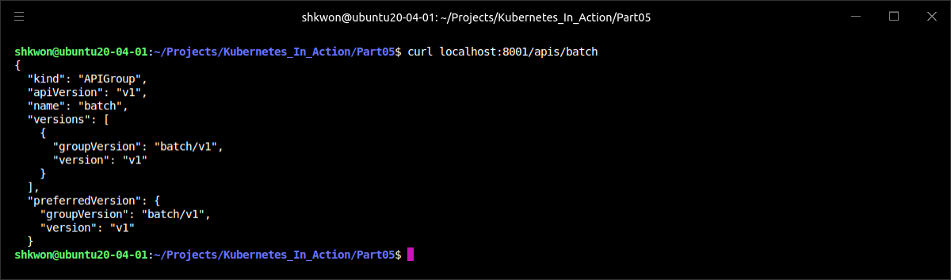
Talking to the Kubernetes API Server(7/33)
Exploring the Kubernetes API Through the kubectl proxy :
  You may recognize the “batch/v1” in the “/apis/batch/v1” path as the API group and version of the Job resources. Likewise, the “/api/v1” corresponds to the “apiVersion: v1” you refer to in the common resources you created (Pods, Services, ReplicationControllers, and so on). The most common resource types, which were introduced in the earliest versions of Kubernetes, don’t belong to any specific group, because Kubernetes initially didn’t even use the concept of API groups.
  NOTE : These initial resource types without an API group are now considered to belong to the core API group.
  For example, let’s explore the Job resource API. You’ll start by looking at what’s behind the “/apis/batch” path (you’ll omit the version for now), as shown in the following listing.
$ curl http://localhost:8001/apis/batch

Slide 24
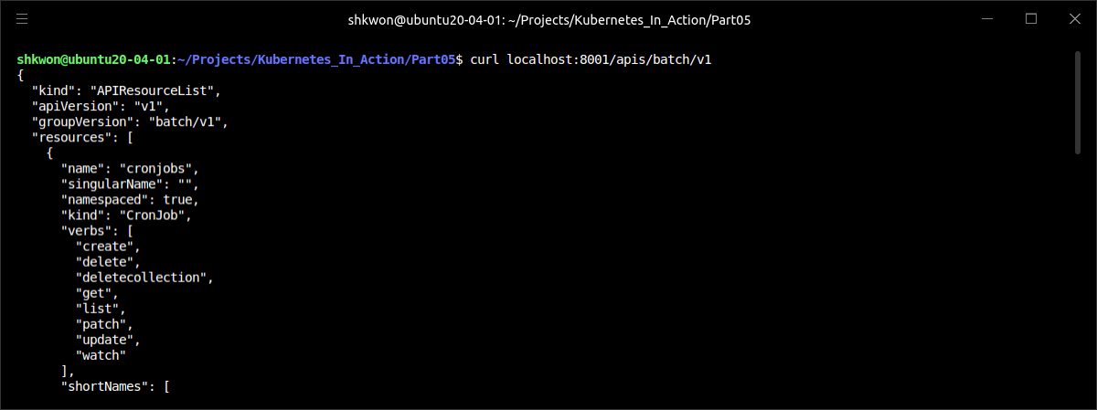
Talking to the Kubernetes API Server(8/33)
Exploring the Kubernetes API Through the kubectl proxy :
  In the previous example, the response shows a description of the batch API group, including the available versions and the preferred version clients should use. Let’s continue and see what’s behind the “/apis/batch/v1” path. It’s shown in the following listing.
$ curl http://localhost:8001/apis/batch/v1

Slide 25
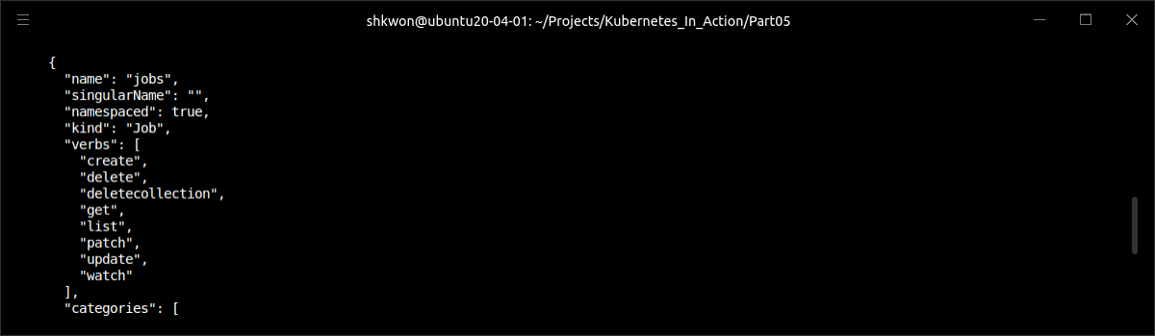
Talking to the Kubernetes API Server(9/33)
Exploring the Kubernetes API Through the kubectl proxy :
  As you can see from the previous example, the API server returns a list of resource types and REST endpoints in the batch/v1 API group. One of those is the Job resource. In addition to the name of the resource and the associated kind, the API server also includes information on whether the resource is namespaced or not, its short name (if it has one; Jobs don’t), and a list of verbs you can use with the resource.
  The returned list describes the REST resources exposed in the API server. The "name": "jobs" line tells you that the API contains the “/apis/batch/v1/jobs” endpoint.
  The "verbs" array says you can get, update, and delete Job resources through that endpoint. For certain resources, additional API endpoints are also exposed (such as the “jobs/status” path, which allows modifying only the status of a Job).

Slide 26
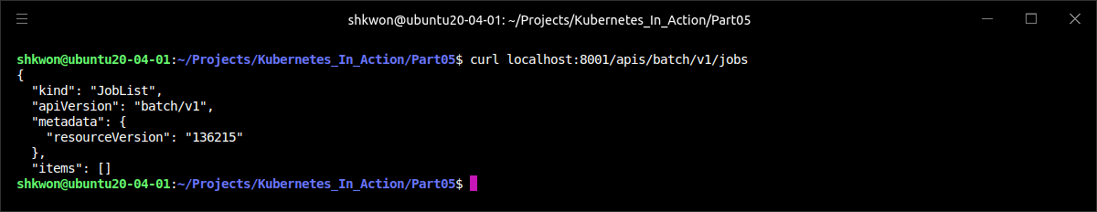
Talking to the Kubernetes API Server(10/33)
Exploring the Kubernetes API Through the kubectl proxy :
  To get a list of Jobs in your cluster, perform a GET request on path “/apis/batch/v1/jobs”, as shown in the following listing.
  NOTE : Now, you probably have no Job resources deployed in your cluster, so the “items” array will be empty.
$ curl http://localhost:8001/apis/batch/v1/jobs

Slide 27
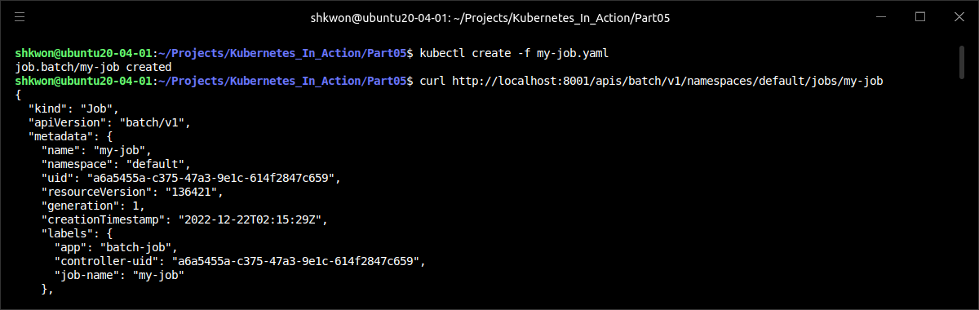
Talking to the Kubernetes API Server(11/33)
Exploring the Kubernetes API Through the kubectl proxy :
  The previous endpoint returned a list of all Jobs across all namespaces. To get back only one specific Job, you need to specify its name and namespace in the URL. To retrieve the Job shown in the previous listing (“name: my-job; namespace: default”), you need to request the following path: “/apis/batch/v1/namespaces/default/jobs/my-job”, as shown in the following listing.
$ kubectl create -f my-job.yaml
$ curl http://localhost:8001/apis/batch/v1/namespaces/default/jobs/my-job

Slide 28
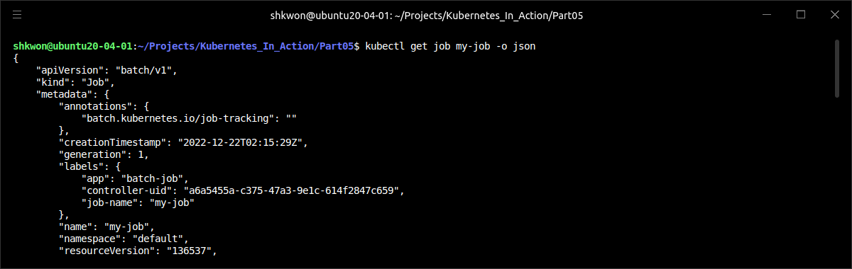
Talking to the Kubernetes API Server(12/33)
Exploring the Kubernetes API Through the kubectl proxy :
  As you can see, you get back the complete JSON definition of the “my-job” Job resource, exactly like you do if you run :
  NOTE : You’ve seen that you can browse the Kubernetes REST API server without using any special tools. For now, exploring it with “curl” like this is enough to make you understand how an application running in a pod talks to Kubernetes.
$ kubectl get job my-job -o json

Slide 29
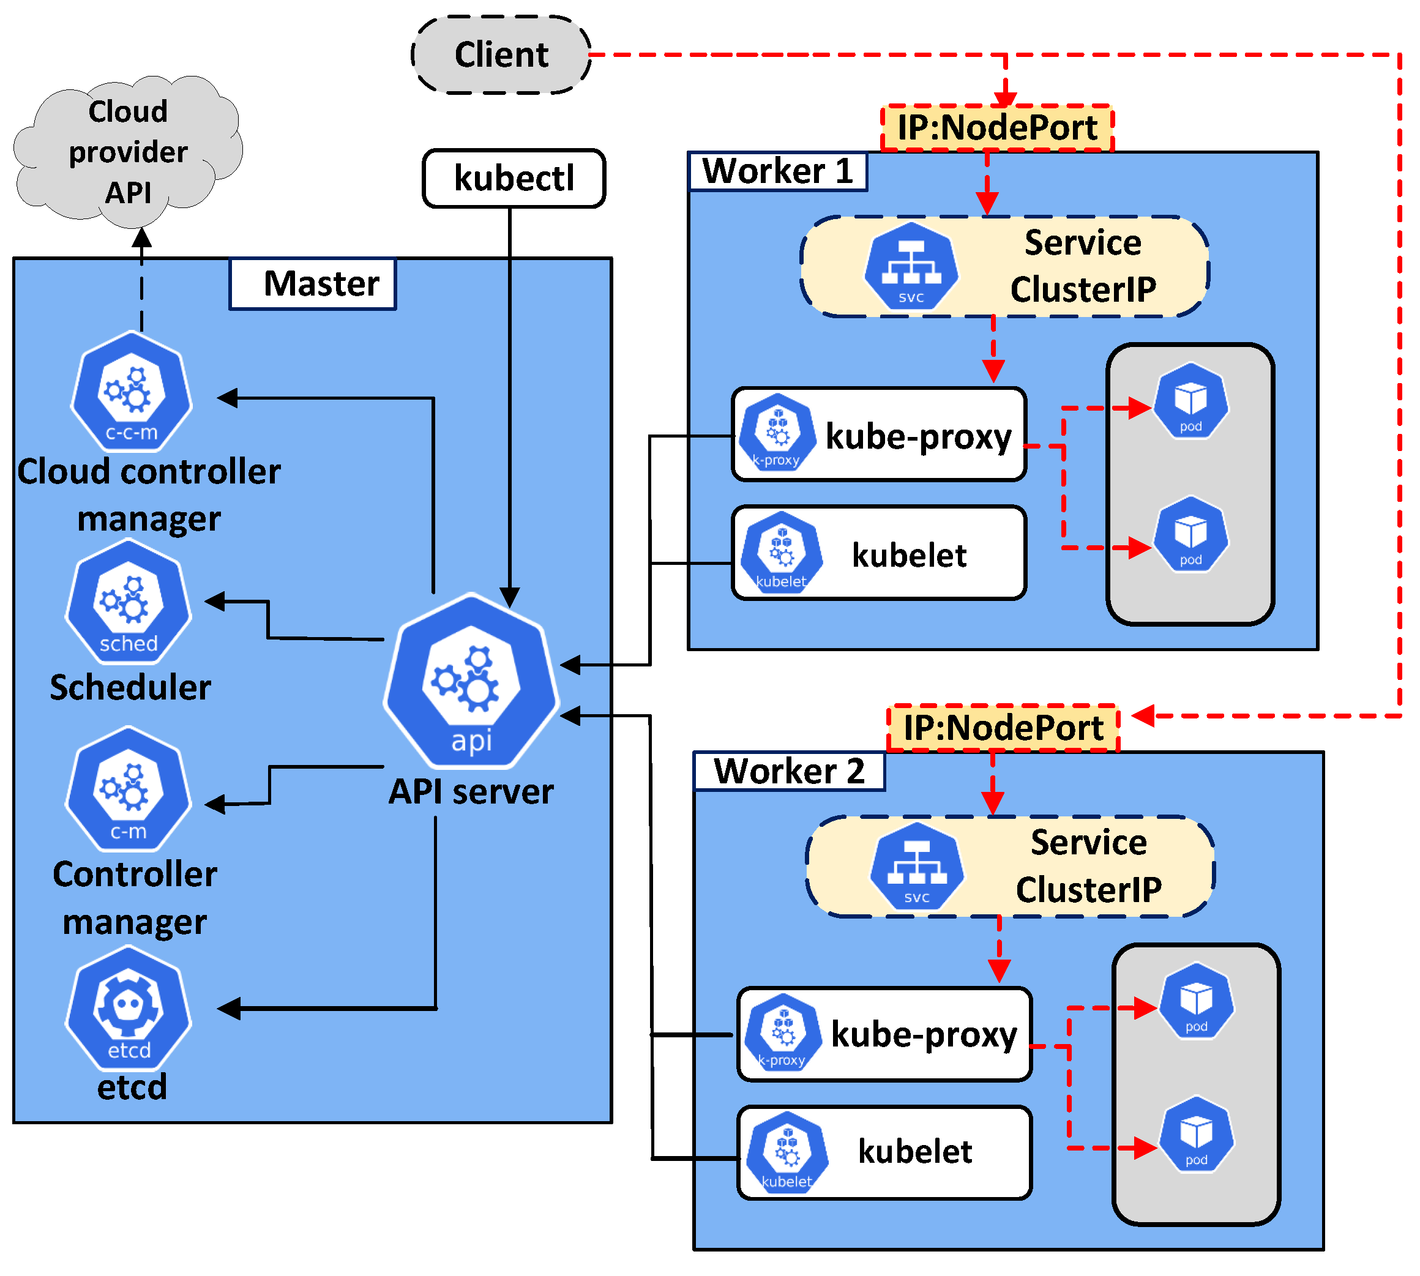
Talking to the Kubernetes API Server(13/33)
Talking to the API Server from within a Pod :
  You’ve learned how to talk to the API server from your local machine, using the “kubectl proxy”. Now, let’s see how to talk to it from within a pod, where you (usually) don’t have “kubectl”. Therefore, to talk to the API server from inside a pod, you need to take care of three things :
    Find the location of the API server.
    Make sure you’re talking to the API server and not something impersonating it.
    Authenticate with the server; otherwise it won’t let you see or do anything.

Slide 30
Talking to the Kubernetes API Server(14/33)
Talking to the API Server from within a Pod :
  The first thing you need is a pod from which to talk to the API server. You’ll run a pod that does nothing (it runs the sleep command in its only container), and then run a shell in the container with “$ kubectl exec” command. Then you’ll try to access the API server from within that shell using “curl”.
  Therefore, you need to use a container image that contains the “curl” binary. If you search for such an image on, say, Docker Hub, you’ll find the “tutum/curl” image, so use it (you can also use any other existing image containing the “curl” binary or you can build your own). The pod definition and Dockerfile for your own are shown in the following listing.
FROM ubuntu:20.04
RUN apt-get update; apt-get -y install curl
ENTRYPOINT [ "/usr/bin/sleep", "1h" ]
curl/Dockerfile
$ docker build -t knix008/curl .
$ docker push knix008/curl
apiVersion: v1
kind: Pod
metadata:
name: curl
spec:
containers:
- name: main
image: knix008/curl:latest
command: ["sleep", "9999999"]
curl-pod.yaml

Slide 31
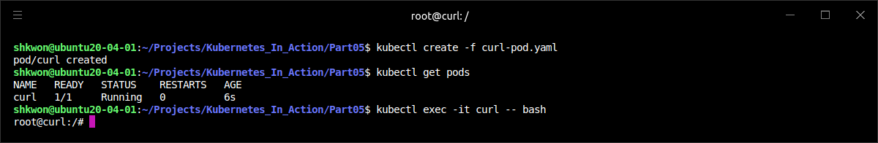
Talking to the Kubernetes API Server(15/33)
Talking to the API Server from within a Pod :
  To create the pod, run “$ kubectl create -f curl-pod.yaml” command. After creating the pod, run “$ kubectl exec” command to run a bash shell inside its container :
$ kubectl create -f curl-pod.yaml
$ kubectl exec -it curl -- bash

Slide 32
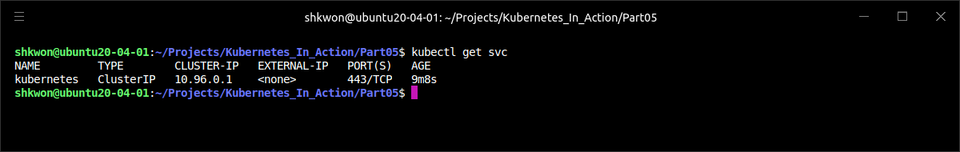
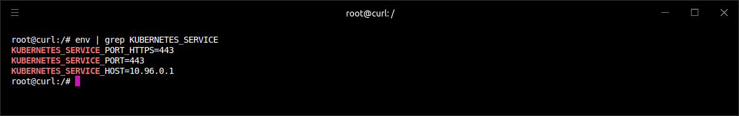
Talking to the Kubernetes API Server(16/33)
Talking to the API Server from within a Pod :
  First, you need to find the IP and port of the Kubernetes API server. This is easy, because a Service called kubernetes is automatically exposed in the default namespace and configured to point to the API server. You may remember seeing it every time you listed services with “$ kubectl get svc” command.
  And environment variables are configured for each service. You can get both the IP address and the port of the API server by looking up the “KUBERNETES_SERVICE_HOST” and “KUBERNETES_SERVICE_PORT” variables (inside the container).
$ kubectl get svc
root@curl: /# env | grep KUBERNETES_SERVICE

Slide 33
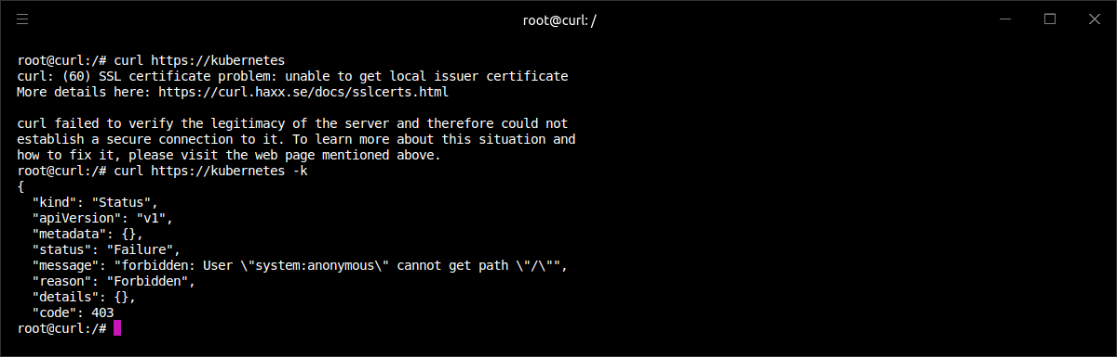
Talking to the Kubernetes API Server(17/33)
Talking to the API Server from within a Pod :
  Each service also gets a DNS entry, so you don’t even need to look up the environment variables, but instead simply point curl to “https://Kubernetes”. To be fair, if you don’t know which port the service is available at, you also either need to look up the environment variables or perform a “DNS SRV record lookup” to get the service’s actual port number.
  The environment variables shown previously say that the API server is listening on port 443, which is the default port for HTTPS, so try hitting the server through HTTPS :
root@curl:/# curl https://kubernetes

Slide 34
Talking to the Kubernetes API Server(18/33)
Talking to the API Server from within a Pod :
  Although the simplest way to get around this is to use the proposed “-k” option (and this is what you’d normally use when playing with the API server manually), let’s look at the longer (and correct) route. Instead of blindly trusting that the server you’re connecting to is the authentic API server, you’ll verify its identity by having “curl” check its certificate.
  NOTICE : Never skip checking the server’s certificate in an actual application. Doing so could make your app expose its authentication token to an attacker using a “man-in-the-middle attack”.

Slide 35
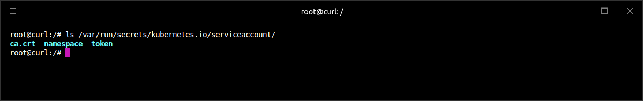
Talking to the Kubernetes API Server(19/33)
Talking to the API Server from within a Pod :
  When we are discussing Secrets, we looked at an automatically created Secret, which is mounted into each container at “/var/run/secrets/kubernetes.io/serviceaccount/”. Let’s see the contents of that Secret again, by listing files in that directory :
  The Secret has three entries (and therefore three files in the Secret volume). Right now, we’ll focus on the “ca.crt” file, which holds the certificate of the certificate authority (CA) used to sign the Kubernetes API server’s certificate.
root@curl:/# ls /var/run/secrets/kubernetes.io/serviceaccount/

Slide 36
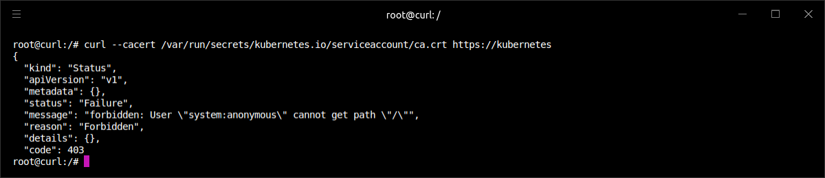
Talking to the Kubernetes API Server(20/33)
Talking to the API Server from within a Pod :
  To verify you’re talking to the API server, you need to check if the server’s certificate is signed by the CA. The “curl” allows you to specify the CA certificate with the “—cacert” option, so try hitting the API server again :
root@curl:/# curl --cacert /var/run/secrets/kubernetes.io/serviceaccount/ca.crt https://kubernetes

Slide 37
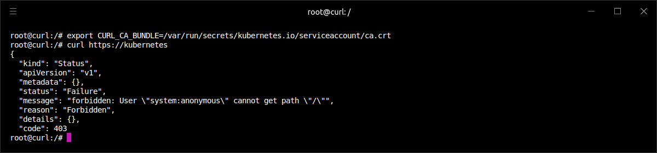
Talking to the Kubernetes API Server(21/33)
Talking to the API Server from within a Pod :
  The “curl” verified the server’s identity because its certificate was signed by the CA you trust. As the Unauthorized response suggests, you still need to take care of authentication. You’ll do that in a moment, but first let’s see how to make life easier by setting the “CURL_CA_BUNDLE” environment variable, so you don’t need to specify “--cacert” every time you run “curl” command :
  This is much nicer now. Your client (“curl”) trusts the API server now, but the API server itself says you’re not authorized to access it, because it doesn’t know who you are.
root@curl:/# export CURL_CA_BUNDLE=/var/run/secrets/kubernetes.io/serviceaccount/ca.crt
root@curl:/# curl https://kubernetes

Slide 38
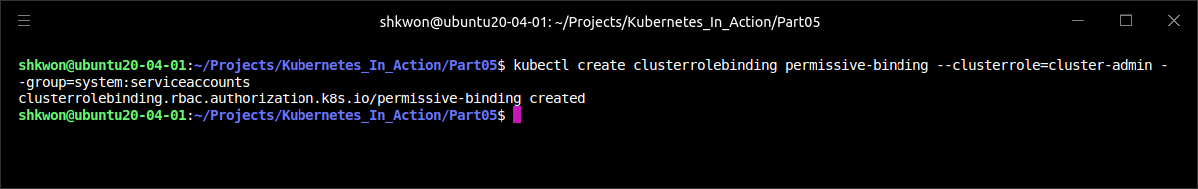
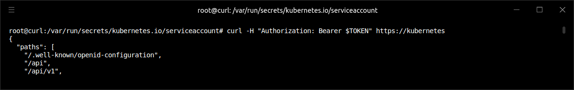
NOTE : Disabling Role-Based Access Control(RBAC)
Cluster Role Binding :
  If you’re using a Kubernetes cluster with RBAC enabled, the service account may not be authorized to access (parts of) the API server. For now, the simplest way to allow you to query the API server is to work around RBAC by running the following command :
  This gives all service accounts (we could also say all pods) cluster-admin privileges, allowing them to do whatever they want.
  NOTICE : Obviously, doing this is dangerous and should never be done on production clusters. For test purposes, it’s fine.
$ kubectl create clusterrolebinding permissive-binding --clusterrole=cluster-admin --group=system:serviceaccounts

Slide 39
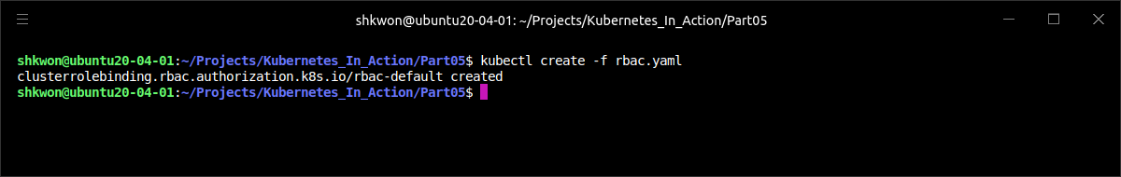
NOTE : RBAC(Role-Based Access Control) Role Binding
Accessing API Server :
  You need to create RBAC ClusterRoleBinding resources to talk to the API server in a pod. The next listing will show you the manifest YAML file.
  NOTE : Before you go further, run the above command.
apiVersion: rbac.authorization.k8s.io/v1
kind: ClusterRoleBinding
metadata:
name: rbac-default
subjects:
- kind: ServiceAccount
name: default
namespace: default
roleRef:
kind: ClusterRole
name: cluster-admin
apiGroup: rbac.authorization.k8s.io
rbac.yaml
kubectl create -f rbac.yaml

Slide 40
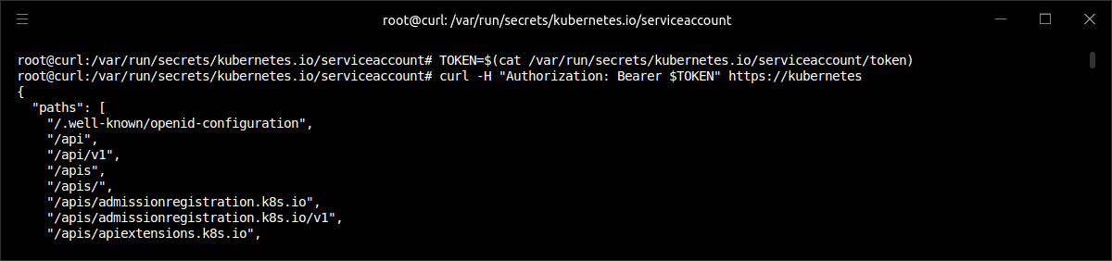
Talking to the Kubernetes API Server(22/33)
Talking to the API Server from within a Pod :
  You need to authenticate with the server, so it allows you to read and even update and/or delete the API objects deployed in the cluster. To authenticate, you need an authentication token. The token is provided through the default-token Secret, and is stored in the token file in the secret volume. As the Secret’s name suggests, that’s the primary purpose of the Secret.
  You’re going to use the token to access the API server. First, load the token into an environment variable :
  NOTE : The token is now stored in the TOKEN environment variable. You can use it when sending requests to the API server, as shown in the following listing.
  As you can see, you passed the token inside the Authorization HTTP header in the request. The API server recognized the token as authentic and returned a proper response. You can now explore all the resources in your cluster, the way you did a few sections ago.
root@curl:/# TOKEN=$(cat /var/run/secrets/kubernetes.io/serviceaccount/token)
root@curl:/# curl -H "Authorization: Bearer $TOKEN" https://kubernetes

Slide 41
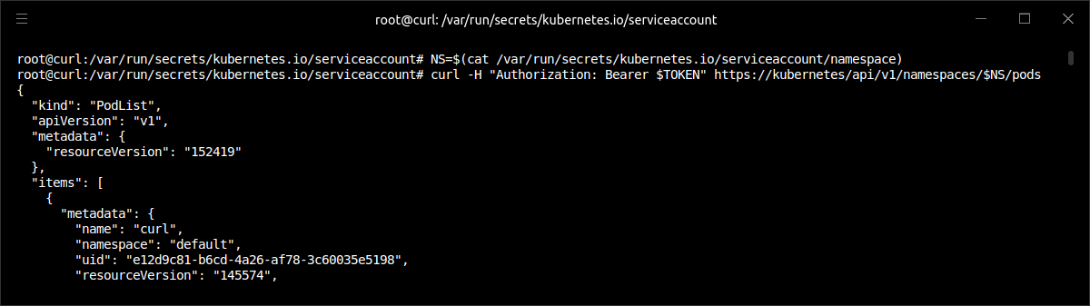
Talking to the Kubernetes API Server(23/33)
Talking to the API Server from within a Pod :
  Your secret volume also contains a file called namespace. It contains the namespace the pod is running in, so you can read the file instead of having to explicitly pass the namespace to your pod through an environment variable. Load the contents of the file into the NS environment variable and then list all the pods, as shown in the following listing.
  NOTE : By using the three files in the mounted secret volume directory, you listed all the pods running in the same namespace as your pod. In the same manner, you could also retrieve other API objects and even update them by sending PUT or PATCH instead of simple GET requests.
root@curl:/# NS=$(cat /var/run/secrets/kubernetes.io/serviceaccount/namespace)
root@curl:/# curl -H "Authorization: Bearer $TOKEN“ https://kubernetes/api/v1/namespaces/$NS/pods

Slide 42
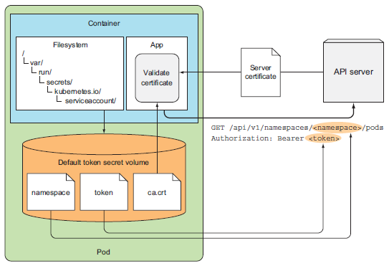
Talking to the Kubernetes API Server(24/33)
Talking to the API Server from within a Pod :
  Let’s recap how an app running inside a pod can access the Kubernetes API properly :
    The app should verify whether the API server’s certificate is signed by the certificate authority, whose certificate is in the “ca.crt” file.
    The app should authenticate itself by sending the Authorization header with the bearer token from the “token” file.
    The namespace file should be used to pass the namespace to the API server when performing CRUD operations on API objects inside the pod’s namespace.
  NOTE : CRUD stands for Create, Read, Update, and Delete. The corresponding HTTP methods are POST, GET, PATCH/PUT, and DELETE, respectively.

Slide 43
Talking to the Kubernetes API Server(25/33)
Simplifying API Server Communication with Ambassador Container :
  Dealing with HTTPS, certificates, and authentication tokens sometimes seems too complicated to developers. You can make the communication much simpler while keeping it secure.
  The “kubectl proxy” command can be used on your local machine to access the API server. Instead of sending requests to the API server directly, you sent them to the proxy and let it take care of authentication, encryption, and server verification. The same method can be used inside your pods, as well.
  Imagine having an application that (among other things) needs to query the API server. Instead of it talking to the API server directly, you can run “kubectl proxy” in an ambassador container alongside the main container and communicate with the API server through it.
  Instead of talking to the API server directly, the app in the main container can connect to the ambassador through HTTP (instead of HTTPS) and let the ambassador proxy handle the HTTPS connection to the API server, taking care of security transparently.
  NOTE : Because all containers in a pod share the same loopback network interface, your app can access the proxy through a port on localhost.

Slide 44
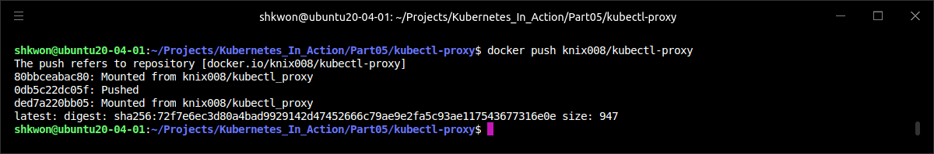
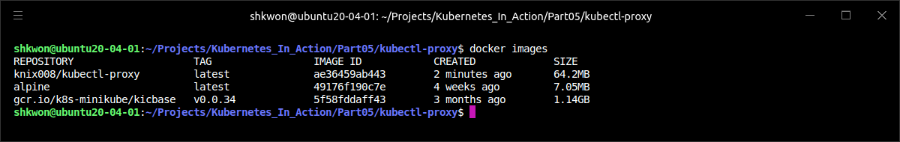
Talking to the Kubernetes API Server(26/33)
Simplifying API Server Communication with Ambassador Container :
  To see the ambassador container pattern in action, you’ll create a new pod like the “curl” pod you created earlier, but this time, instead of running a single container in the pod, you’ll run an additional ambassador container based on a general-purpose “kubectl-proxy” container image.
FROM alpine
RUN apk update && apk add curl && curl -L -O https://dl.k8s.io/v1.8.0/kubernetes-client-linux-amd64.tar.gz && tar zvxf kubernetes-client-linux-amd64.tar.gz kubernetes/client/bin/kubectl && mv kubernetes/client/bin/kubectl / && rm -rf kubernetes && rm -f kubernetes-client-linux-amd64.tar.gz
ADD kubectl-proxy.sh /kubectl-proxy.sh
ENTRYPOINT /kubectl-proxy.sh
kubectl-proxy/Dockerfile
$ docker build -t knix008/kubectl-proxy .
$ docker push knix008/kubectl-proxy

Slide 45
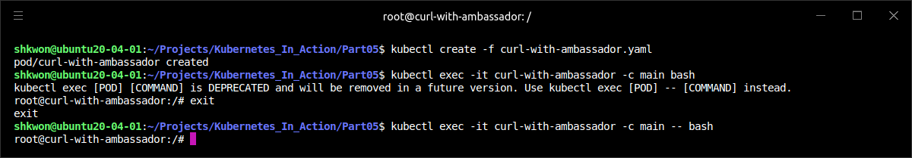
Talking to the Kubernetes API Server(27/33)
Simplifying API Server Communication with Ambassador Container :
  The pod’s manifest is shown in the following listing. The pod spec is almost the same as before, but with a different pod name and an additional container.
  NOTE : You can use “$ kubectl exec -it curl-with-ambassador -c main -- bash” command instead.
apiVersion: v1
kind: Pod
metadata:
name: curl-with-ambassador
spec:
containers:
- name: main
image: knix008/curl:latest
command: ["sleep", "9999999"]
- name: ambassador
image: knix008/kubectl-proxy:latest
curl-with-ambassador.yaml
$ kubectl create -f curl-with-ambassador.yaml
$ kubectl exec -it curl-with-ambassador -c main bash

Slide 46
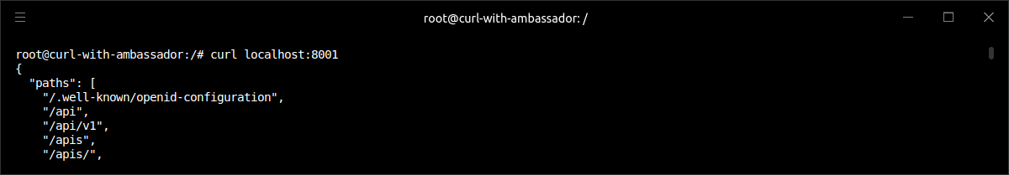
Talking to the Kubernetes API Server(28/33)
Simplifying API Server Communication with Ambassador Container :
  Your pod now has two containers, and you want to run “bash” in the “main” container, hence the “-c main” option. You don’t need to specify the container explicitly if you want to run the command in the pod’s first container. But if you want to run a command inside any other container, you do need to specify the container’s name using the “-c” option.
  Next you’ll try connecting to the API server through the ambassador container. By default, “kubectl proxy” binds to port 8001, and because both containers in the pod share the same network interfaces, including loopback, you can point “curl” to “localhost:8001”, as shown in the following listing.
  NOTE : The output printed by “curl” is the same response you saw earlier, but this time you didn’t need to deal with authentication tokens and server certificates.
root@curl-with-ambassador:/# curl localhost:8001

Slide 47
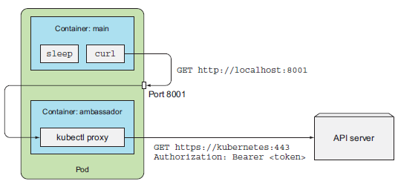
Talking to the Kubernetes API Server(29/33)
Simplifying API Server Communication with Ambassador Container :
  To get a clear picture of what exactly happened, refer to the following figure. The “curl” sent the plain HTTP request (without any authentication headers) to the proxy running inside the ambassador container, and then the proxy sent an HTTPS request to the API server, handling the client authentication by sending the token and checking the server’s identity by validating its certificate.
  This is a great example of how an ambassador container can be used to hide the complexities of connecting to an external service and simplify the app running in the main container. The ambassador container is reusable across many different apps, regardless of what language the main app is written in. The downside is that an additional process is running and consuming additional resources.
kubectl-proxy/kubectl-proxy.sh
#!/bin/sh
API_SERVER="https://$KUBERNETES_SERVICE_HOST:$KUBERNETES_SERVICE_PORT"
CA_CRT="/var/run/secrets/kubernetes.io/serviceaccount/ca.crt"
TOKEN="$(cat /var/run/secrets/kubernetes.io/serviceaccount/token)"
/kubectl proxy --server="$API_SERVER" --certificate-authority="$CA_CRT" --token="$TOKEN" --accept-paths='^.*'

Slide 48
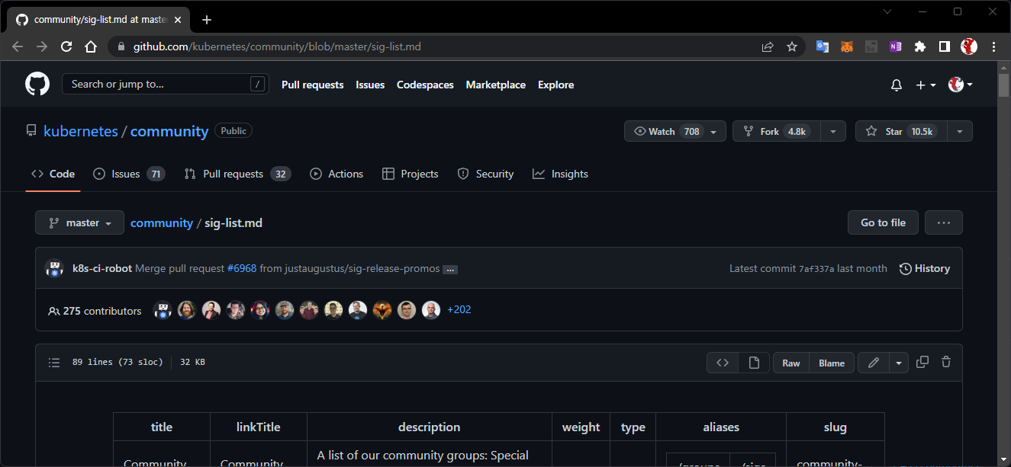
Talking to the Kubernetes API Server(30/33)
Using Client Libraries to Talk to the API Server :
  If your app only needs to perform a few simple operations on the API server, you can often use a regular HTTP client library and perform simple HTTP requests, especially if you take advantage of the “kubectl-proxy” ambassador container the way you did in the previous example. But if you plan on doing more than simple API requests, it’s better to use one of the existing Kubernetes API client libraries.
  Currently, two Kubernetes API client libraries exist that are supported by the API Machinery Special Interest Group (SIG):
    Golang client — https://github.com/kubernetes/client-go
    Python client — https://github.com/kubernetes-incubator/client-python
  NOTE The Kubernetes community has a number of Special Interest Groups (SIGs) and Working Groups(WG) that focus on specific parts of the Kubernetes ecosystem. You’ll find a list of them at https://github.com/kubernetes/community/blob/master/sig-list.md.

Slide 49
Talking to the Kubernetes API Server(31/33)
Using Client Libraries to Talk to the API Server :
  In addition to the two officially supported libraries, here’s a list of user-contributed client libraries for many other languages :
      ○ Java client by Fabric8 - https://github.com/fabric8io/kubernetes-client
      ○ Java client by Amdatu - https://bitbucket.org/amdatulabs/amdatu-kubernetes
      ○ Node.js client by tenxcloud - https://github.com/tenxcloud/node-kubernetes-client
      ○ Node.js client by GoDaddy - https://github.com/godaddy/kubernetes-client
      ○ PHP - https://github.com/devstub/kubernetes-api-php-client
      ○ Another PHP client - https://github.com/maclof/kubernetes-client
      ○ Ruby - https://github.com/Ch00k/kubr
      ○ Another Ruby client - https://github.com/abonas/kubeclient
      ○ Clojure - https://github.com/yanatan16/clj-kubernetes-api
      ○ Scala - https://github.com/doriordan/skuber
      ○ Perl - https://metacpan.org/pod/Net::Kubernetes
  These libraries usually support HTTPS and take care of authentication, so you won’t need to use the ambassador container.

Slide 50
Talking to the Kubernetes API Server(32/33)
Using Client Libraries to Talk to the API Server :
  To give you a sense of how client libraries enable you to talk to the API server, the following listing shows an example of how to list services in a Java app using the Fabric8 Kubernetes client.
package kubia;
import io.fabric8.kubernetes.api.model.Pod;
import io.fabric8.kubernetes.api.model.PodList;
import io.fabric8.kubernetes.client.DefaultKubernetesClient;
import io.fabric8.kubernetes.client.KubernetesClient;
import java.util.Arrays;
public class Fabric8ClientTest {
public static void main(String[] args) throws Exception {
KubernetesClient client = new DefaultKubernetesClient();
// list pods in the default namespace
PodList pods = client.pods().inNamespace("default").list();
pods.getItems().stream().forEach(s -> System.out.println("Found pod: " + s.getMetadata().getName()));
// create a pod
System.out.println("Creating a pod");
Pod pod = client.pods().inNamespace("default").createNew()
.withNewMetadata()
.withName("my-programmatically-created-pod")
.endMetadata()
.withNewSpec()
.addNewContainer()
.withName("main")
.withImage("busybox")
.withCommand(Arrays.asList("sleep", "99999"))
.endContainer()
.endSpec()
.done();
System.out.println("Created pod: " + pod);
…
Fabric8ClientTest.java

Slide 51
Talking to the Kubernetes API Server(33/33)
Using Client Libraries to Talk to the API Server :
  The code should be self-explanatory, especially because the Fabric8 client exposes a nice, fluent “Domain-Specific-Language (DSL) API”, which is easy to read and understand.
  NOTICE!!! : If you have any problem in running minikube like after manual editing some configuration files, run “$ minikube delete” and run “$ minikube start” again. It will delete all configuration and certificates related to the previous running of minikube and re-initialize all the configuration.
…
// edit the pod (add a label to it)
client.pods().inNamespace("default").withName("my-programmatically-created-pod").edit()
.editMetadata()
.addToLabels("foo", "bar")
.endMetadata()
.done();
System.out.println("Added label foo=bar to pod");
System.out.println("Waiting 1 minute before deleting pod...");
Thread.sleep(60000);
// delete the pod
client.pods().inNamespace("default").withName("my-programmatically-created-pod").delete();
System.out.println("Deleted the pod");
}
}
Fabric8ClientTest.java

Slide 52
Deployments
Updating Application Declaratively

Slide 53
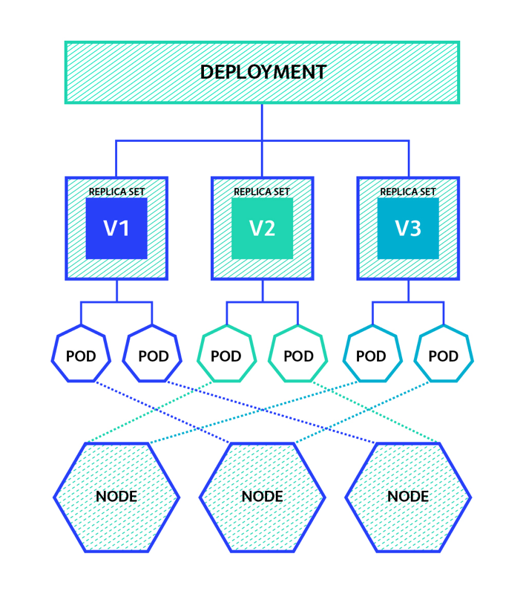
What is Deployments?
Deployments in Kubernetes :
  Here we will cover how to update apps running in a Kubernetes cluster and how Kubernetes helps you move toward a true zero-downtime update process. Although this can be achieved using only ReplicationControllers or ReplicaSets, Kubernetes also provides a Deployment resource that sits on top of ReplicaSets and enables declarative application updates.

Slide 54
Updating Applications Running in Pods(1/5)
Updating Applications :
  Imagine having a set of pod instances providing a service to other pods and/or external clients. You recognize that these pods are backed by a ReplicationController or a ReplicaSet. A Service also exists through which clients (apps running in other pods or external clients) access the pods. This is how a basic application looks in Kubernetes (shown in the following figure).
  Initially, the pods run the first version of your application—let’s suppose its image is tagged as “v1”. You then develop a newer version of the app and push it to an image repository as a new image, tagged as “v2”. You’d next like to replace all the pods with this new version. Because you can’t change an existing pod’s image after the pod is created, you need to remove the old pods and replace them with new ones running the new image.

Slide 55
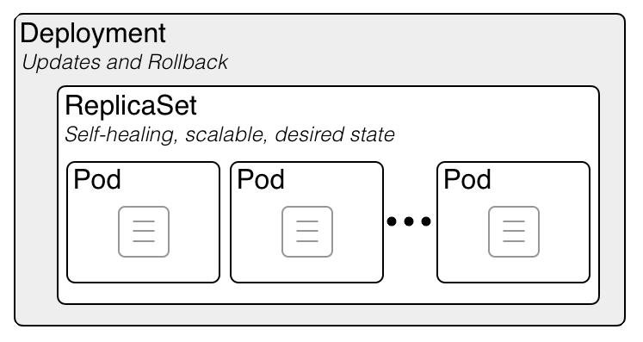
Updating Applications Running in Pods(2/5)
Updating Applications :
  You have two ways of updating all those pods. You can do one of the following :
    Delete all existing pods first and then start the new ones.
    Start new ones and, once they’re up, delete the old ones. You can do this either by adding all the new pods and then deleting all the old ones at once, or sequentially, by adding new pods and removing old ones gradually.
  Both these strategies have their benefits and drawbacks. The first option would lead to a short period of time when your application is unavailable. The second option requires your app to handle running two versions of the app at the same time. If your app stores data in a data store, the new version shouldn’t modify the data schema or the data in such a way that breaks the previous version.

Slide 56
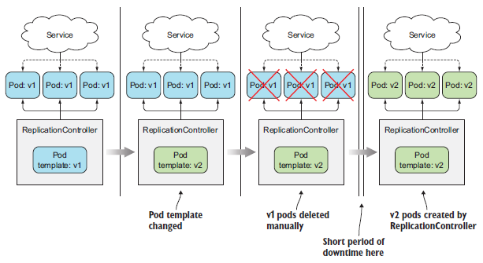
Updating Applications Running in Pods(3/5)
Deleting Old Pods and Replacing Them with New Ones :
  You already know how to get a ReplicationController to replace all its pod instances with pods running a new version. The pod template of a ReplicationController can be updated at any time. When the ReplicationController creates new instances, it uses the updated pod template to create them.
  If you have a ReplicationController managing a set of “v1” pods, you can easily replace them by modifying the pod template so it refers to version “v2” of the image and then deleting the old pod instances. The ReplicationController will notice that no pods match its label selector and it will spin up new instances. The whole process is shown in the following figure.
  This is the simplest way to update a set of pods, if you can accept the short downtime between the time the old pods are deleted and new ones are started.

Slide 57
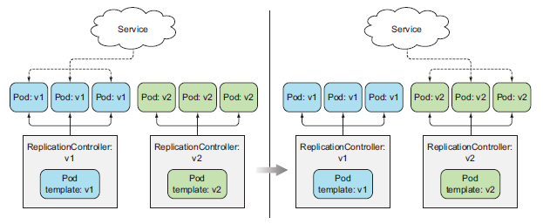
Updating Applications Running in Pods(4/5)
Spinning up New Pods and Then Deleting Old Ones :
  If you don’t want to see any downtime and your app supports running multiple versions at once, you can turn the process around and first spin up all the new pods and only then delete the old ones. This will require more hardware resources, because you’ll have double the number of pods running at the same time for a short while.
  Pods are usually fronted by a Service. It’s possible to have the Service front only the initial version of the pods while you bring up the pods running the new version. Then, once all the new pods are up, you can change the Service’s label selector and have the Service switch over to the new pods, as shown in the following figure. This is called a blue-green deployment. After switching over, and once you’re sure the new version functions correctly, you’re free to delete the old pods by deleting the old ReplicationController.
  NOTE : You can change a Service’s pod selector with the “$ kubectl set selector” command.

Slide 58
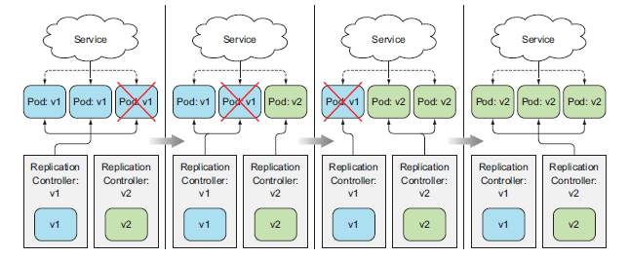
Updating Applications Running in Pods(5/5)
Spinning up New Pods and Then Deleting Old Ones :
  Instead of bringing up all the new pods and deleting the old pods at once, you can also perform a rolling update, which replaces pods step by step. You do this by slowly scaling down the previous ReplicationController and scaling up the new one. In this case, you’ll want the Service’s pod selector to include both the old and the new pods, so it directs requests toward both sets of pods. See the following figure.

Slide 59
Performing a Rolling Update with a ReplicationController(1/7)
Running the Initial Version of the App :
  Instead of performing rolling updates using ReplicationControllers manually, you can have kubectl perform them. Using kubectl to perform the update makes the process much easier, but this is now an outdated way of updating apps. Nevertheless, we’ll walk through this option first, because it was historically the first way of doing an automatic rolling update, and also allows us to discuss the process without introducing too many additional concepts.
  Obviously, before you can update an app, you need to have an app deployed. You’re going to use a slightly modified version of the “kubia NodeJS app” you created before as your initial version. In case you don’t remember what it does, it’s a simple webapp that returns the pod’s hostname in the HTTP response.
  You’ll change the app so it also returns its version number in the response, which will allow you to distinguish between the different versions you’re about to build. The following listing shows the app’s code.
const http = require('http');
const os = require('os');
console.log("Kubia server starting...");
var handler = function(request, response) {
console.log("Received request from " + request.connection.remoteAddress);
response.writeHead(200);
response.end("This is v1 running in pod " + os.hostname() + "\n");
};
var www = http.createServer(handler);
www.listen(8080);
v1/app.js

Slide 60
Performing a Rolling Update with a ReplicationController(2/7)
Running the Initial Version of the App :
  To run your app, you’ll create a ReplicationController and a LoadBalancer Service to enable you to access the app externally. This time, rather than create these two resources separately, you’ll create a single YAML for both of them and post it to the Kubernetes API with a single “$ kubectl create” command. A YAML manifest can contain multiple objects delimited with a line containing three dashes, as shown in the following listing.
apiVersion: v1
kind: ReplicationController
metadata:
name: kubia-v1
spec:
replicas: 3
template:
metadata:
name: kubia
labels:
app: kubia
spec:
containers:
- image: knix008/kubia:v1
name: nodejs
---
apiVersion: v1
kind: Service
metadata:
name: kubia
spec:
type: LoadBalancer
selector:
app: kubia
ports:
- port: 80
targetPort: 8080
kubia-rc-and-service-v1.yaml

Slide 61
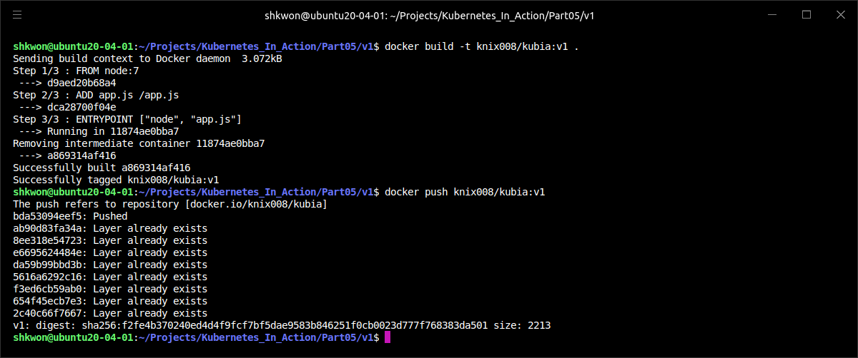
NOTE : Building Docker Image and Pushing
Building Images and Pushing into Docker Hub Repository :
  Before you run the examples in this part, you need to build docker image and push it into your Docker hub repository. Run the following commands in “v1” directory.
$ docker build -t knix008/kubia:v1 .
$ docker push knix008/kubia:v1

Slide 62
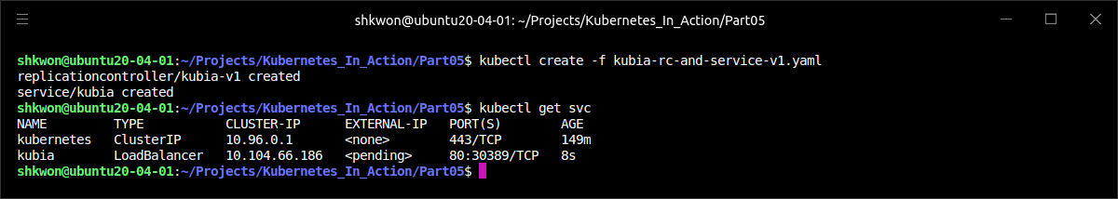
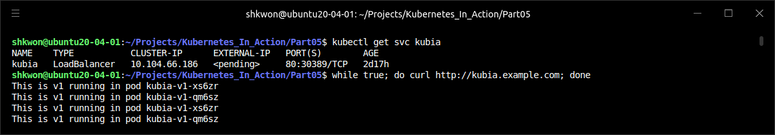
Performing a Rolling Update with a ReplicationController(3/7)
Running the Initial Version of the App :
  The YAML defines a ReplicationController called “kubia-v1” and a Service called “kubia”. Go ahead and post the YAML to Kubernetes. After a while, your three “v1” pods and the load balancer should all be running, so you can look up the Service’s external IP and start hitting the service with “curl”, as shown in the following listing.
  NOTE : Here you used “LoadBalancer” type. If you are using Minikube, you need to use “Ingress” for exposing your service to external clients.

Slide 63
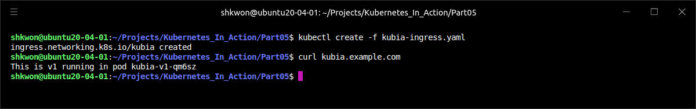
NOTE : Ingress Controller with ReplicationController
Running Ingress for Exposing Service Externally :
  When you are using LoadBalancer type for service in Minikube cluster, you need to run the “Ingress” controller for exposing your service to the outside world like the following. You also need to add entry to the “/etc/hosts” file.
apiVersion: networking.k8s.io/v1
kind: Ingress
metadata:
name: kubia
spec:
rules:
- host: kubia.example.com
http:
paths:
- path: /
pathType: Prefix
backend:
service:
name: kubia
port:
number: 80
kubia-ingress.yaml
$ kubectl create -f kubia-ingress.yaml

Slide 64

Performing a Rolling Update with a ReplicationController(4/7)
Performing a Rolling Update with kubectl :
  Next you’ll create version 2 of the app. To keep things simple, all you’ll do is change the response to say, “This is v2” :
  This new version is available in the image “knix008/kubia:v2” on Docker Hub.
…
response.end("This is v2 running in pod " + os.hostname() + "\n");
…

Slide 65

NOTE : Pushing Updates to the Same Image Tag to Docker Hub
Docker Image Tag in Docker Hub :
  Modifying an app and pushing the changes to the same image tag isn’t a good idea, but we all tend to do that during development. If you’re modifying the latest tag, that’s not a problem, but when you’re tagging an image with a different tag (for example, tag “v1” instead of latest), once the image is pulled by a worker node, the image will be stored on the node and not pulled again when a new pod using the same image is run (at least that’s the default policy for pulling images).
  That means any changes you make to the image won’t be picked up if you push them to the same tag. If a new pod is scheduled to the same node, the Kubelet will run the old version of the image. On the other hand, nodes that haven’t run the old version will pull and run the new image, so you might end up with two different versions of the pod running. To make sure this doesn’t happen, you need to set the container’s “imagePullPolicy” property to “Always”.
  You need to be aware that the default “imagePullPolicy” depends on the image tag. If a container refers to the latest tag (either explicitly or by not specifying the tag at all), “imagePullPolicy” defaults to “Always”, but if the container refers to any other tag, the policy defaults to “IfNotPresent”.
  When using a tag other than latest, you need to set the “imagePullPolicy” properly if you make changes to an image without changing the tag. Or better yet, make sure you always push changes to an image under a new tag.

Slide 66


Performing a Rolling Update with a ReplicationController(5/7)
Performing a Rolling Update with kubectl :
  Keep the curl loop running and open another terminal, where you’ll get the rolling update started. To perform the update to the “v2”, you need to create new YAML file for “v2”. Then you can also create new replication controller with “v2” YAML file. If the “v2” ReplicationControler is full working, then you can delete the “v1” ReplicationController.
  NOTICE : The “kubectl rolling-update” command is deprecated and removed from the kubectl commands. So you cannot use it now(2022.12).
$ kubectl create -f kubia-rc-v2.yaml

Slide 67


Performing a Rolling Update with a ReplicationController(6/7)
Performing a Rolling Update with kubectl :
  The new ReplicationController’s pod template references the “knix008/kubia:v2” image and its initial desired replica count is set to 0. Then it will be 3 sometime later.

Slide 68

Performing a Rolling Update with a ReplicationController(7/7)
Performing a Rolling Update with kubectl :
  When the update process is being performed by the client instead of on the server and, what if you lost network connectivity while kubectl was performing the update? The update process would be interrupted mid-way. Pods and ReplicationControllers would end up in an intermediate state. Another reason why performing an update like this isn’t as good as it could be is because it’s imperative.
  The better way is telling the desired state of the system and having Kubernetes achieve that state on its own, by figuring out the best way to do it. This is how pods are deployed and how pods are scaled up and down. You never tell Kubernetes to add an additional pod or remove an excess one—you change the number of desired replicas and that’s it.
  Similarly, you will also want to change the desired image tag in your pod definitions and have Kubernetes replace the pods with new ones running the new image. This is exactly what drove the introduction of a new resource called a Deployment, which is now the preferred way of deploying applications in Kubernetes.

Slide 69
Using Deployments for Updating Apps Declaratively(1/39)
Deployment and ReplicaSet :
  Deployment is a higher-level resource meant for deploying applications and updating them declaratively, instead of doing it through a ReplicationController or a ReplicaSet, which are both considered lower-level concepts.
  When you create a Deployment, a ReplicaSet resource is created underneath (eventually more of them). ReplicaSets are a new generation of ReplicationControllers, and should be used instead of them. ReplicaSets replicate and manage pods, as well. When using a Deployment, the actual pods are created and managed by the Deployment’s ReplicaSets, not by the Deployment directly (the relationship is shown in the following figure).
  When updating the app, you need to introduce an additional ReplicationController and coordinate the two controllers to dance around each other without stepping on each other’s toes. A Deployment resource takes care of that (it’s not the Deployment resource itself, but the controller process running in the Kubernetes control plane that does that).
  Using a Deployment instead of the lower-level constructs makes updating an app much easier, because you’re defining the desired state through the single Deployment resource and letting Kubernetes take care of the rest.

Slide 70
Using Deployments for Updating Apps Declaratively(2/39)
Creating a Deployment :
  Creating a Deployment isn’t that different from creating a ReplicationController. A Deployment is also composed of a label selector, a desired replica count, and a pod template. In addition to that, it also contains a field, which specifies a deployment strategy that defines how an update should be performed when the Deployment resource is modified.
  Let’s see how to use the “kubia-v1” ReplicationController example from earlier and modify it so it describes a Deployment instead of a ReplicationController. As you’ll see, this requires only three trivial changes. The following listing shows the modified YAML.
  NOTE : You’ll find an older version of the Deployment resource in “extensions/v1beta1”, and a newer one in “apps/v1beta2” or “apps/v1” with different required fields and different defaults. Be aware that kubectl explain shows the older version.
apiVersion: apps/v1
kind: Deployment
metadata:
name: kubia
spec:
replicas: 3
template:
metadata:
name: kubia
labels:
app: kubia
spec:
containers:
- image: knix008/kubia:v1
name: nodejs
selector:
matchLabels:
app: kubia
kubia-deployment-v1.yaml

Slide 71

Using Deployments for Updating Apps Declaratively(3/39)
Creating a Deployment :
  Because the ReplicationController from before was managing a specific version of the pods, you called it “kubia-v1”. A Deployment, on the other hand, is above that version stuff. At a given point in time, the Deployment can have multiple pod versions running under its wing, so its name shouldn’t reference the app version.
  Before you create this Deployment, make sure you delete any ReplicationControllers and pods that are still running, but keep the “kubia” Service for now. You can use the “--all” switch to delete all those ReplicationControllers(rc) like this :
  You’re now ready to create the Deployment:
  NOTE : Be sure to include the “--record” command-line option when creating it. This records the command in the revision history, which will be useful later. But, it is deprecated now(2022.12).
$ kubectl delete rc --all
$ kubectl create -f kubia-deployment-v1.yaml --record

Slide 72

Using Deployments for Updating Apps Declaratively(4/39)
Creating a Deployment :
  You can use the usual “$ kubectl get deployment” and the “$ kubectl describe deployment” commands to see details of the Deployment, but let me point you to an additional command, which is made specifically for checking a Deployment’s status :
  According to the above screenshot, the Deployment has been successfully rolled out, so you should see the three pod replicas up and running.
  NOTE : Here you already created “Ingress” using “$ kubectl create -f kubia-ingress.yaml” command.
$ kubectl rollout status deployment kubia

Slide 73

Using Deployments for Updating Apps Declaratively(5/39)
Creating a Deployment :
  Take note of the names of these pods. Earlier, when you used a ReplicationController to create pods, their names were composed of the name of the controller plus a randomly generated string (for example, “kubia-v1-m33mv”). The three pods created by the Deployment include an additional numeric value in the middle of their names.
  The number corresponds to the hashed value of the pod template in the Deployment and the ReplicaSet managing these pods. As we said earlier, a Deployment doesn’t manage pods directly. Instead, it creates ReplicaSets and leaves the managing to them, so let’s look at the ReplicaSet created by your Deployment :
  NOTE : The ReplicaSet’s name also contains the hash value of its pod template. As you’ll see later, a Deployment creates multiple ReplicaSets—one for each version of the pod template. Using the hash value of the pod template allows the Deployment to always use the same (possibly existing) ReplicaSet for a given version of the pod template.
$ kubectl get replicasets

Slide 74

Using Deployments for Updating Apps Declaratively(6/39)
Creating a Deployment :
  With the three replicas created by this ReplicaSet now running, you can use the Service you created a while ago to access them, because you made the new pods’ labels match the Service’s label selector. Up until this point, you probably haven’t seen a good-enough reason why you should use Deployments over ReplicationControllers. Luckily, creating a Deployment also hasn’t been any harder than creating a ReplicationController. Now, you’ll start doing things with this Deployment, which will make it clear why Deployments are superior.

Slide 75

Using Deployments for Updating Apps Declaratively(7/39)
Updating a Deployment :
  With ReplicationController, Kubernetes replaced all the original pods with new ones and deleted the original ReplicationController at the end of the process. During the process, you basically had to stay around, keeping your terminal open and waiting for “kubectl” to finish the update.
  Now compare this to how you’re about to update a Deployment. The only thing you need to do is modify the pod template defined in the Deployment resource and Kubernetes will take all the steps necessary to get the actual system state to what’s defined in the resource. Similar to scaling a ReplicationController or ReplicaSet up or down, all you need to do is reference a new image tag in the Deployment’s pod template and leave it to Kubernetes to transform your system so it matches the new desired state.
Service

Slide 76

Using Deployments for Updating Apps Declaratively(8/39)
Updating a Deployment :
  How this new state should be achieved is governed by the deployment strategy configured on the Deployment itself. The default strategy is to perform a rolling update (the strategy is called RollingUpdate). The alternative is the Recreate strategy, which deletes all the old pods at once and then creates new ones, similar to modifying a ReplicationController’s pod template and then deleting all the pods.
  The Recreate strategy causes all old pods to be deleted before the new ones are created. Use this strategy when your application doesn’t support running multiple versions in parallel and requires the old version to be stopped completely before the new one is started. This strategy does involve a short period of time when your app becomes completely unavailable(downtime).
  The RollingUpdate strategy, on the other hand, removes old pods one by one, while adding new ones at the same time, keeping the application available throughout the whole process, and ensuring there’s no drop in its capacity to handle requests. This is the default strategy. The upper and lower limits for the number of pods above or below the desired replica count are configurable. You should use this strategy only when your app can handle running both the old and new version at the same time(compatible).
Recreate Strategy

Slide 77

Using Deployments for Updating Apps Declaratively(9/39)
Updating a Deployment :
  In the next example, you’ll use the RollingUpdate strategy, but you need to slow down the update process a little, so you can see that the update is indeed performed in a rolling fashion. You can do that by setting the “minReadySeconds” attribute on the Deployment. For now, set it to “10” seconds with the “kubectl patch” command.
  NOTE : The “kubectl patch” command is useful for modifying a single property or a limited number of properties of a resource without having to edit its definition in a text editor.
  You used the patch command to change the spec of the Deployment. This doesn’t cause any kind of update to the pods, because you didn’t change the pod template. Changing other Deployment properties, like the desired replica count or the deployment strategy, also doesn’t trigger a rollout, because it doesn’t affect the existing individual pods in any way.
$ kubectl patch deployment kubia -p '{"spec": {"minReadySeconds": 10}}'

Slide 78

Using Deployments for Updating Apps Declaratively(10/39)
Updating a Deployment :
  If you’d like to track the update process as it progresses, first run the “curl” loop again in another terminal to see what’s happening with the requests (don’t forget to replace the IP with the actual external IP of your service) :
  To trigger the actual rollout, you’ll change the image used in the single pod container to “knix008/kubia:v2”. Instead of editing the whole YAML of the Deployment object or using the “patch” command to change the image, you’ll use the “$ kubectl set image” command, which allows changing the image of any resource that contains a container (ReplicationControllers, ReplicaSets, Deployments, and so on).
$ while true; do curl http://kubia.example.com; done

Slide 79


Using Deployments for Updating Apps Declaratively(11/39)
Updating a Deployment :
  You’ll use it to modify your Deployment like this :
  NOTE : When you execute the above command, you’re updating the “kubia” Deployment’s pod template so the image used in its “nodejs” container is changed to “knix008/kubia:v2” (from :v1).
$ kubectl set image deployment kubia nodejs=knix008/kubia:v2

Slide 80
Using Deployments for Updating Apps Declaratively(12/39)
Updating a Deployment :
  The following figure shows you what happened after the execution of the previous command.
All these methods are equivalent as far as Deployments go. What they do is change the Deployment’s specification. This change then triggers the rollout process.

Slide 81

Using Deployments for Updating Apps Declaratively(13/39)
Updating a Deployment :
  By changing the pod template in your Deployment resource, you’ve updated your app to a newer version.
  The controllers running as part of the Kubernetes control plane then performed the update. The process wasn’t performed by the kubectl client. It is much simpler than having to run a special command telling Kubernetes what to do and then waiting around for the process to be completed.
  NOTE : Be aware that if the pod template in the Deployment references a ConfigMap (or a Secret), modifying the ConfigMap will not trigger an update. One way to trigger an update when you need to modify an app’s config is to create a new ConfigMap and modify the pod template so it references the new ConfigMap.
  An additional ReplicaSet was created and it was then scaled up slowly, while the previous ReplicaSet was scaled down to zero (the initial and final states are shown in the following figure).

Slide 82

Using Deployments for Updating Apps Declaratively(14/39)
Updating a Deployment :
  You can still see the old ReplicaSet next to the new one if you list them :
  Similar to ReplicationControllers, all your new pods are now managed by the new ReplicaSet. Unlike before, the old ReplicaSet is still there, whereas the old ReplicationController was deleted at the end of the update process. You’ll soon see what the purpose of this inactive ReplicaSet is.
  But you shouldn’t care about ReplicaSets here, because you didn’t create them directly. You created and operated only on the Deployment resource; the underlying ReplicaSets are an implementation detail. You’ll agree that managing a single Deployment object is much easier compared to dealing with and keeping track of multiple ReplicationControllers.
  Although this difference may not be so apparent when everything goes well with a rollout, it becomes much more obvious when you hit a problem during the rollout process.
$ kubectl get rs

Slide 83
Using Deployments for Updating Apps Declaratively(15/39)
Rolling Back a Deployment :
  You’re currently running version v2 of your image, so you’ll need to prepare version 3 first. In version 3, you’ll introduce a bug that makes your app handle only the first four requests properly. All requests from the fifth request onward will return an internal server error (HTTP status code 500). You’ll simulate this by adding an “if” statement at the beginning of the handler function. The following listing shows the new code, with all required changes shown in red.
const http = require('http');
const os = require('os');
var requestCount = 0;
console.log("Kubia server starting...");
var handler = function(request, response) {
console.log("Received request from " + request.connection.remoteAddress);
if (++requestCount >= 5) {
response.writeHead(500);
response.end("Some internal error has occurred! This is pod " + os.hostname() + "\n");
return;
}
response.writeHead(200);
response.end("This is v3 running in pod " + os.hostname() + "\n");
};
var www = http.createServer(handler);
www.listen(8080);
v3/app.js

Slide 84

Using Deployments for Updating Apps Declaratively(16/39)
Rolling Back a Deployment :
  Before you use the code, you need to make Docker image and push it into Docker hub repository. The following command will do the things for you.
$ docker build -t knix008/kubia:v3 .
$ docker push knix008/kubia:v3

Slide 85


Using Deployments for Updating Apps Declaratively(17/39)
Rolling Back a Deployment :
  Now you can deploy this new version by changing the image in the Deployment specification again :
  You can follow the progress of the rollout with kubectl rollout status :
$ kubectl set image deployment kubia nodejs=knix008/kubia:v3
$ kubectl rollout status deployment kubia

Slide 86

Using Deployments for Updating Apps Declaratively(18/39)
Rolling Back a Deployment :
  The new version is now live. As the following listing shows, after a few requests, your web clients start receiving errors.
$ while true; do curl http://kubia.example.com; done

Slide 87


Using Deployments for Updating Apps Declaratively(19/39)
Rolling Back a Deployment :
  You can’t have your users experiencing internal server errors, so you need to do something about it fast. Luckily, Deployments make it easy to roll back to the previously deployed version by telling Kubernetes to undo the last rollout of a Deployment :
  NOTE : The undo command can also be used while the rollout process is still in progress to essentially abort the rollout. Pods already created during the rollout process are removed and replaced with the old ones again.
$ kubectl rollout undo deployment kubia

Slide 88

Using Deployments for Updating Apps Declaratively(20/39)
Rolling Back a Deployment :
  Rolling back a rollout is possible because Deployments keep a revision history. The history is stored in the underlying ReplicaSets. When a rollout completes, the old ReplicaSet isn’t deleted, and this enables rolling back to any revision, not only the previous one. The revision history can be displayed with the kubectl rollout history command :
  NOTE : Remember the “--record” command-line option you used when creating the Deployment? Without it, the “CHANGE-CAUSE” column in the revision history would be empty, making it much harder to figure out what’s behind each revision.
$ kubectl rollout history deployment kubia

Slide 89

Using Deployments for Updating Apps Declaratively(21/39)
Rolling Back a Deployment :
  You can roll back to a specific revision by specifying the revision in the undo command. For example, if you want to roll back to the third(the revision number - you can find it in the previous page) version, you’d execute the following command :
  Remember the inactive ReplicaSet left over when you modified the Deployment the first time? The ReplicaSet represents the first revision of your Deployment. All ReplicaSets created by a Deployment represent the complete revision history.
  NOTE : Each ReplicaSet stores the complete information of the Deployment at that specific revision, so you shouldn’t delete it manually. If you do, you’ll lose that specific revision from the Deployment’s history, preventing you from rolling back to it.
$ kubectl rollout undo deployment kubia --to-revision=3

Slide 90

Using Deployments for Updating Apps Declaratively(22/39)
Rolling Back a Deployment :
  But having old ReplicaSets cluttering your ReplicaSet list is not ideal, so the length of the revision history is limited by the “revisionHistoryLimit” property on the Deployment resource. It defaults to two, so normally only the current and the previous revision are shown in the history (and only the current and the previous ReplicaSet are preserved). Older ReplicaSets are deleted automatically.

Slide 91

Using Deployments for Updating Apps Declaratively(23/39)
Controlling the Rate of the Rollout :
  When you performed the rollout to “v3” and tracked its progress with the “kubectl rollout status” command, you saw that first a new pod was created, and when it became available, one of the old pods was deleted and another new pod was created. This continued until there were no old pods left. The way new pods are created and old ones are deleted is configurable through two additional properties of the rolling update strategy.
  Two properties affect how many pods are replaced at once during a Deployment’s rolling update. They are “maxSurge” and “maxUnavailable” and can be set as part of the “rollingUpdate” sub-property of the Deployment’s “strategy” attribute, as shown in the following listing.
…
spec:
strategy:
rollingUpdate:
maxSurge: 1
maxUnavailable: 0
type: RollingUpdate
…

Slide 92
Using Deployments for Updating Apps Declaratively(24/39)
Controlling the Rate of the Rollout :
  Because the desired replica count in your case was three, and both these properties default to 25%, maxSurge allowed the number of all pods to reach four, and maxUnavailable disallowed having any unavailable pods (in other words, three pods had to be available at all times). This is shown in the following figure.

Slide 93

Using Deployments for Updating Apps Declaratively(25/39)
Controlling the Rate of the Rollout :
  The “extensions/v1beta1” version of Deployments uses different defaults—it sets both maxSurge and maxUnavailable to 1 instead of 25%. In the case of three replicas, maxSurge is the same as before, but maxUnavailable is different (1 instead of 0). This makes the rollout process unwind a bit differently, as shown in the following figure.
  In this case, one replica can be unavailable, so if the desired replica count is three, only two of them need to be available. That’s why the rollout process immediately deletes one pod and creates two new ones. This ensures two pods are available and that the maximum number of pods isn’t exceeded (the maximum is four in this case—three plus one from maxSurge). As soon as the two new pods are available, the two remaining old pods are deleted.
  This is a bit hard to grasp, especially since the maxUnavailable property leads you to believe that that’s the maximum number of unavailable pods that are allowed. If you look at the above figure closely, you’ll see two unavailable pods in the second column even though maxUnavailable is set to 1.
  It’s important to keep in mind that maxUnavailable is relative to the desired replica count. If the replica count is set to three and maxUnavailable is set to one, that means that the update process must always keep at least two (3 minus 1) pods available, while the number of pods that aren’t available can exceed one.

Slide 94

Using Deployments for Updating Apps Declaratively(26/39)
Pausing the Rollout Process :
  After the bad experience with version 3 of your app, imagine you’ve now fixed the bug and pushed version 4 of your image. You’re a little apprehensive about rolling it out across all your pods the way you did before. What you want is to run a single v4 pod next to your existing v2 pods and see how it behaves with only a fraction of all your users. Then, once you’re sure everything’s okay, you can replace all the old pods with new ones.
  You could achieve this by running an additional pod either directly or through an additional Deployment, ReplicationController, or ReplicaSet, but you do have another option available on the Deployment itself. A Deployment can also be paused during the rollout process. This allows you to verify that everything is fine with the new version before proceeding with the rest of the rollout.
  Before we go further, we need to prepare the Docker image for “v4” and push it into Docker Hub repository using the following commands.
  NOTE : You can find the image in Docker Hub.
$ docker build -t knix008/kubia:v4 .
$ docker push knix008/kubia:v4

Slide 95


Using Deployments for Updating Apps Declaratively(27/39)
Pausing the Rollout Process :
  Now, we have the “v4” image, so go ahead and trigger the rollout by changing the image to “knix008/kubia:v4”, but then immediately (within a few seconds) pause the rollout :
$ kubectl set image deployment kubia nodejs=knix008/kubia:v4
$ kubectl rollout pause deployment kubia

Slide 96

Using Deployments for Updating Apps Declaratively(28/39)
Pausing the Rollout Process :
  A single new pod should have been created, but all original pods should also still be running. Once the new pod is up, a part of all requests to the service will be redirected to the new pod. This way, you’ve effectively run a canary release.
  A canary release is a technique for minimizing the risk of rolling out a bad version of an application and it affecting all your users. Instead of rolling out the new version to everyone, you replace only one or a small number of old pods with new ones. This way only a small number of users will initially hit the new version. You can then verify whether the new version is working fine or not and then either continue the rollout across all remaining pods or roll back to the previous version.

Slide 97

Using Deployments for Updating Apps Declaratively(29/39)
Pausing the Rollout Process :
  Once you’re confident the new version works as it should, you can resume the deployment to replace all the old pods with new ones :
  NOTE : Obviously, having to pause the deployment at an exact point in the rollout process isn’t what you want to do. In the future, a new upgrade strategy may do that automatically, but currently, the proper way of performing a canary release is by using two different Deployments and scaling them appropriately.
$ kubectl rollout resume deployment kubia

Slide 98

Using Deployments for Updating Apps Declaratively(30/39)
Pausing the Rollout Process :
  Pausing a Deployment can also be used to prevent updates to the Deployment from kicking off the rollout process, allowing you to make multiple changes to the Deployment and starting the rollout only when you’re done making all the necessary changes. Once you’re ready for changes to take effect, you resume the Deployment and the rollout process will start.
  NOTE : If a Deployment is paused, the undo command won’t undo it until you resume the Deployment.
Pause / Resume

Slide 99

Using Deployments for Updating Apps Declaratively(31/39)
Blocking Rollouts of Bad Versions :
  Remember the “minReadySeconds” property you set on the Deployment at the beginning? You used it to slow down the rollout, so you could see it was indeed performing a rolling update and not replacing all the pods at once. The main function of “minReadySeconds” is to prevent deploying malfunctioning versions, not slowing down a deployment for fun.
  The “minReadySeconds” property specifies how long a newly created pod should be ready before the pod is treated as available. Until the pod is available, the rollout process will not continue (remember the “maxUnavailable” property?). A pod is ready when readiness probes of all its containers return a success. If a new pod isn’t functioning properly and its readiness probe starts failing before “minReadySeconds” have passed, the rollout of the new version will effectively be blocked.
  Usually, you’d set “minReadySeconds” to something much higher to make sure pods keep reporting they’re ready after they’ve already started receiving actual traffic.
  Although you should obviously test your pods both in a test and in a staging environment before deploying them into production, using “minReadySeconds” is like an airbag that saves your app from making a big mess after you’ve already let a buggy version slip into production.
  With a properly configured “readiness probe“ and a proper “minReadySeconds“ setting, Kubernetes would have prevented us from deploying the buggy “v3” version earlier.

Slide 100
Using Deployments for Updating Apps Declaratively(32/39)
Blocking Rollouts of Bad Versions :
  You’re going to deploy version v3 again, but this time, you’ll have the proper readiness probe defined on the pod. Your Deployment is currently at version v4, so before you start, roll back to version v2 again so you can pretend this is the first time you’re upgrading to v3. If you wish, you can go straight from v4 to v3, but the text that follows assumes you returned to v2 first.
  Unlike before, where you only updated the image in the pod template, you’re now also going to introduce a readiness probe for the container at the same time. Up until now, because there was no explicit readiness probe defined, the container and the pod were always considered ready, even if the app wasn’t truly ready or was returning errors. There was no way for Kubernetes to know that the app was malfunctioning and shouldn’t be exposed to clients.
  To change the image and introduce the readiness probe at once, you’ll use the “kubectl apply” command. You’ll use the following YAML to update the deployment, as shown in the following listing.
apiVersion: apps/v1
kind: Deployment
metadata:
name: kubia
spec:
replicas: 3
minReadySeconds: 10
strategy:
rollingUpdate:
maxSurge: 1
maxUnavailable: 0
type: RollingUpdate
template:
metadata:
name: kubia
labels:
app: kubia
spec:
containers:
- image: knix008/kubia:v3
name: nodejs
readinessProbe:
periodSeconds: 1
httpGet:
path: /
port: 8080
selector:
matchLabels:
app: kubia
kubia-deployment-v3-with-readinesscheck.yaml

Slide 101

Using Deployments for Updating Apps Declaratively(33/39)
Blocking Rollouts of Bad Versions :
  To update the Deployment, you’ll use “kubectl apply” like this :
  Here, we created “v2” Deployment with “kubia-deployment-v2.yaml”. Then we used the above command to update the configuration of “kubia” Deployment from “v2” to “v3”.
  The “apply” command updates the Deployment with everything that’s defined in the YAML file. It not only updates the image but also adds the readiness probe definition and anything else you’ve added or modified in the YAML. If the new YAML also contains the replicas field, which doesn’t match the number of replicas on the existing Deployment, the apply operation will also scale the Deployment, which isn’t usually what you want.
  NOTE : To keep the desired replica count unchanged when updating a Deployment with kubectl apply, don’t include the replicas field in the YAML.
$ kubectl apply -f kubia-deployment-v3-with-readinesscheck.yaml

Slide 102


Using Deployments for Updating Apps Declaratively(34/39)
Blocking Rollouts of Bad Versions :
  Running the apply command will kick off the update process, which you can again follow with the rollout status command :
  Because the status says “error : the deployment “kubia” is exceeded its progress deadline”(readiness probe failed), your service will show you the following screenshot :
$ kubectl rollout status deployment kubia
$ while true; do curl http://kubia.example.com; done

Slide 103

Using Deployments for Updating Apps Declaratively(35/39)
Blocking Rollouts of Bad Versions :
  You never hit the v3 pod. Why not? Is it even there? List the pods :
  As you can see from the above screenshot, There’s your problem. The pod is shown as not ready. What has happened?
$ kubectl get pods

Slide 104

Using Deployments for Updating Apps Declaratively(36/39)
Blocking Rollouts of Bad Versions :
  As soon as your new pod starts, the readiness probe starts being hit every second (you set the probe’s interval to one second in the pod spec). On the fifth request the readiness probe began failing, because your app starts returning HTTP status code 500 from the fifth request onward.
  As a result, the pod is removed as an endpoint from the service (see the following figure). By the time you start hitting the service in the “curl” loop, the pod has already been marked as not ready. This explains why you never hit the new pod with “curl”. And that’s exactly what you want, because you don’t want clients to hit a pod that’s not functioning properly.

Slide 105

Using Deployments for Updating Apps Declaratively(37/39)
Blocking Rollouts of Bad Versions :
  The rollout status command shows there was an error in updating the Deployment. The rollout process will not continue, because the new pod will never become available. To be considered available, it needs to be ready for at least “10” seconds. Until it’s available, the rollout process will not create any new pods, and it also won’t remove any original pods because you’ve set the “maxUnavailable” property to 0.
  The fact that the deployment is stuck is a good thing, because if it had continued replacing the old pods with the new ones, you’d end up with a completely non-working service. But now, with the readiness probe in place, there was virtually no negative impact on your users.
  NOTE : If you only define the readiness probe without setting “minReadySeconds” properly, new pods are considered available immediately when the first invocation of the readiness probe succeeds. If the readiness probe starts failing shortly after, the bad version is rolled out across all pods. Therefore, you should set “minReadySeconds” appropriately.

Slide 106


Using Deployments for Updating Apps Declaratively(38/39)
Blocking Rollouts of Bad Versions :
  By default, after the rollout can’t make any progress in “10” minutes, it’s considered as failed. If you use the “$ kubectl describe deployment” command, you’ll see it display a “ProgressDeadlineExceeded” condition, as shown in the following screenshot.
$ kubectl describe deploy kubia

Slide 107


Using Deployments for Updating Apps Declaratively(39/39)
Blocking Rollouts of Bad Versions :
  The time after which the Deployment is considered failed is configurable through the “progressDeadlineSeconds” property in the Deployment spec.
  Because the rollout will never continue, the only thing to do now is abort the rollout by undoing it :
$ kubectl rollout undo deployment kubia

Slide 108

Reference
[1] Kubernetes in Action, Marko Luksa, Manning, 2018 1st Edition.
[2] https://github.com/luksa/kubernetes-in-action
[3] https://minikube.sigs.k8s.io/docs/

Slide 109

? & !

